Slide 1
YOUR WEBINAR WILL BEGIN SHORTLY
Audio test may occur during this period

Slide 2


Slide 3


NAVIGATING ZOOM

Slide 4
YOUR WEBINAR WILL BEGIN SHORTLY

Slide 5


Slide 6

Industry Engagement
Informing vs Validating
Melanie Alexandra

Slide 7

ABOUT: MELANIE ALEXANDRA
Melanie has held a variety of teaching, leadership, management, and regulatory roles within the VET sector for almost 30 years.
Melanie has also developed a range of training, assessment, management and governance tools and resources to support VET practitioners nationally, including a number of professional development programs to aid learning through online platforms.
As the Vocational Education Services Advisor for Independent Schools Queensland Melanie now directly supports practitioners delivering vocational education in schools and is also a VET Compliance and Quality Assurance Consultant in her own right.
Phone: 0411 174 548
Email: vetexcel@consultant.com
Linkedin: Melanie Alexandra (VETExcel)

Slide 8
WEBINAR OVERVIEW
Informing Industry Relevant Resources
01
Engagement Strategies
02
Preparing Targeted Questions
03
Using Engagement Outcomes
04

Slide 9

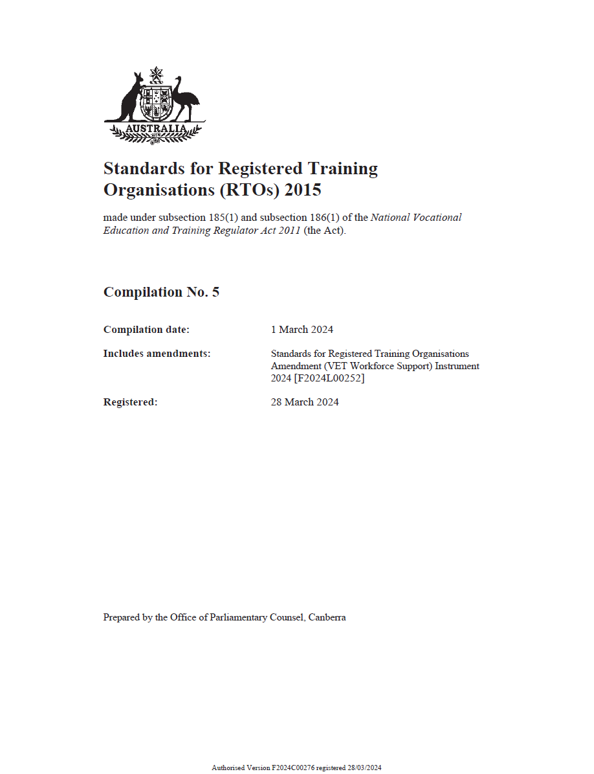
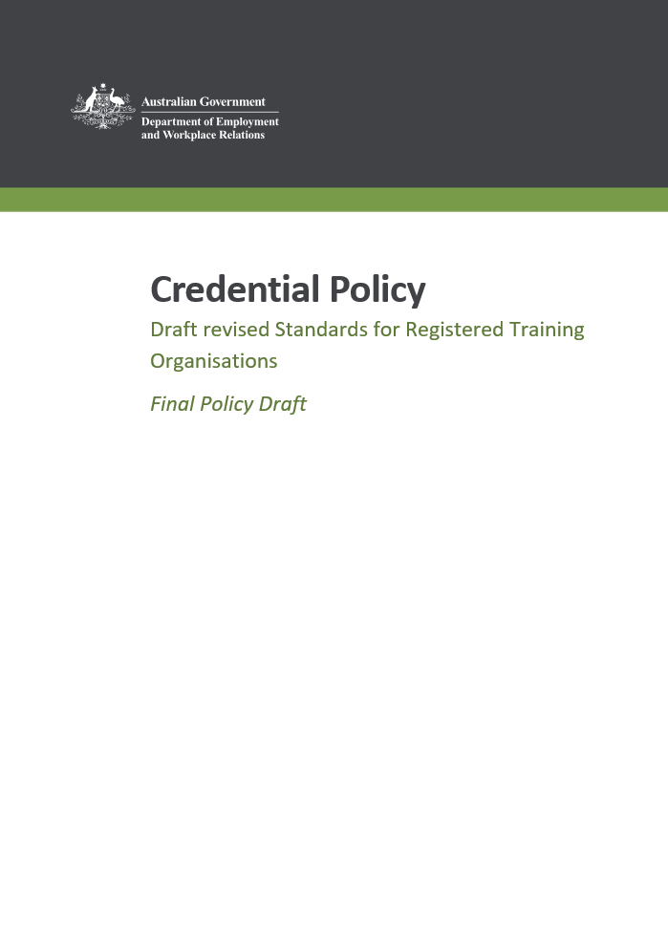
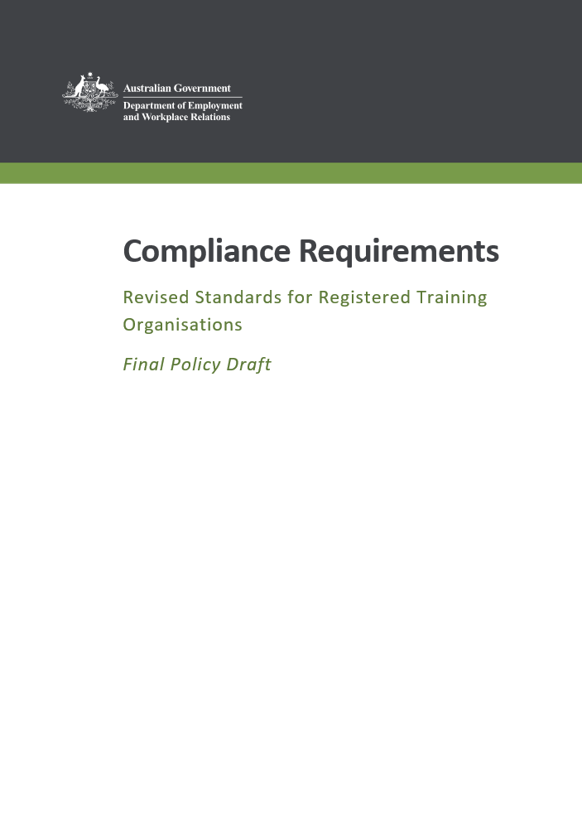
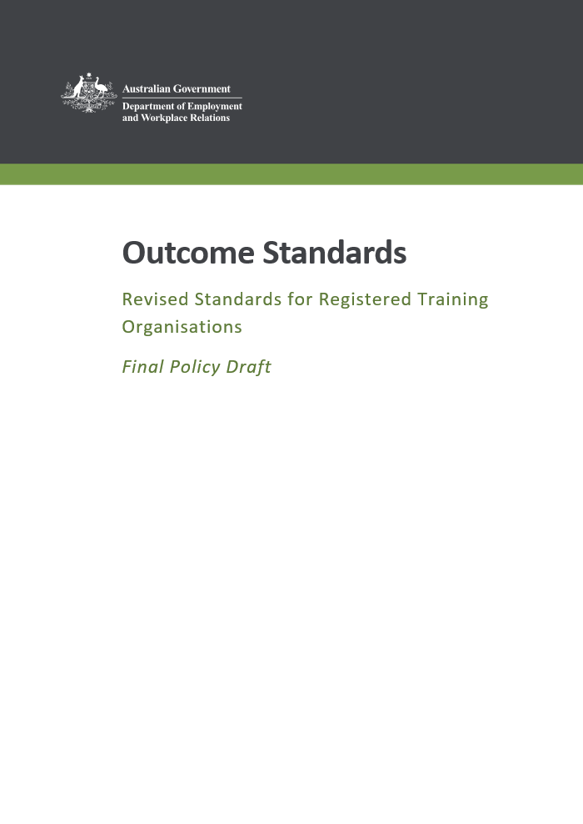
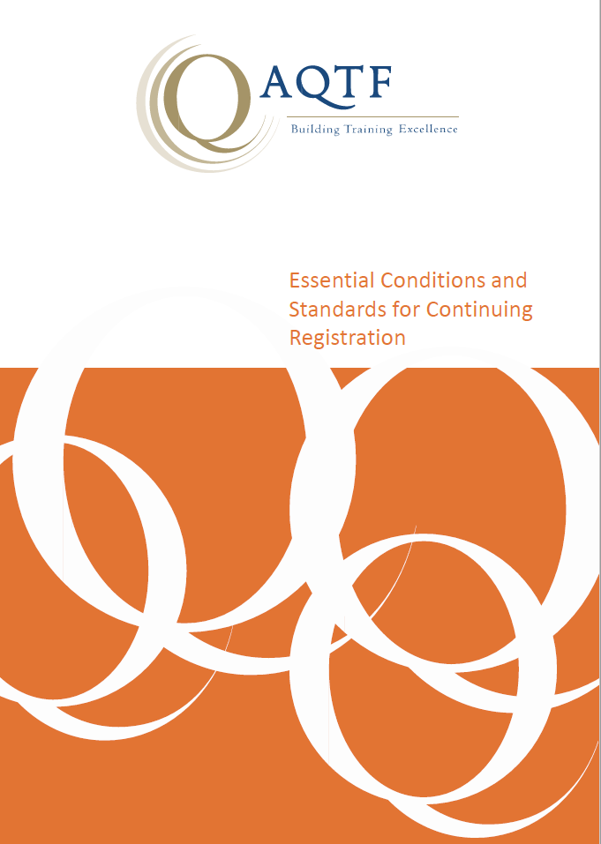
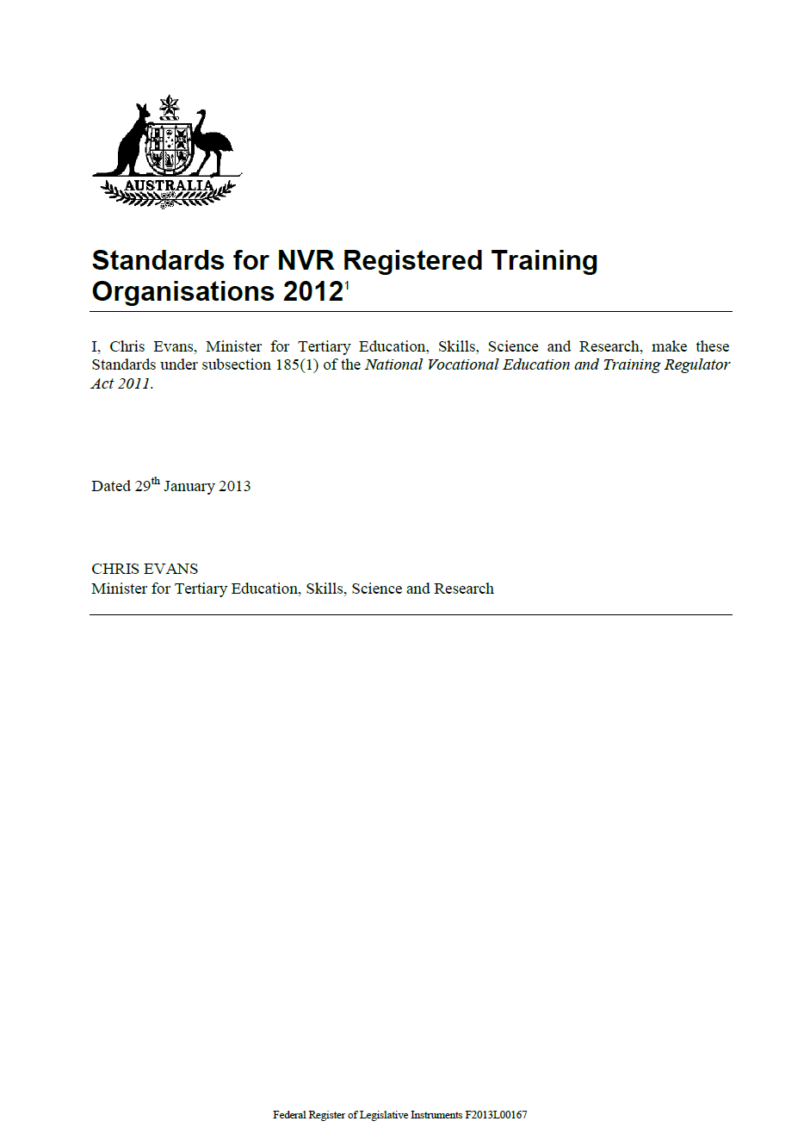
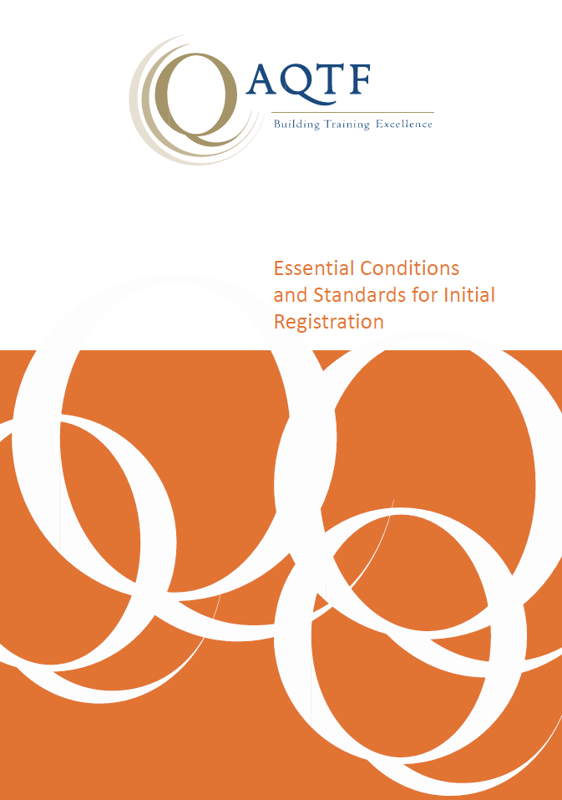
The Standards ….
2025
Notes:
Highlighting the point that engaging and consulting with industry for the purpose of informing our practices is nothing new. This has been the case through many iterations of the legislated Standards and frameworks.

Slide 10

Informing vs Validating
The purpose of engagement with industry is to strengthen and inform training assessment.
The new revised Standards therefore consolidate the requirements to engage with industry and community representatives and remove industry engagement as a distinct quality area.
Notes:
The VET Sector has been confusing the two meanings.
I go into RTOs and trainers commonly use the term ‘validate my TAS’ and ‘validate my profile’ and I often think, where did they get this term? What is it they think they have to do?
Poor old industry representative who commonly knows very little about VET but everything about their industry, is not required to validate education documents.
So, let’s unpack this, enable the quality assurance of our future processes, and start with unpacking these two terms ‘informing’ and ‘validating’.

Slide 11
Informing vs Validating
Inform
RTOs are ‘informed’ by industry representatives to ensure that the industry relevance of their training and assessment strategies, practices and resources meets current industry requirements.
Validate
RTOs appoint a validator or validators to validate assessment judgements and practices against the Principles of Assessment and Rules of Evidence. Industry representatives may be engaged as part of an assessment validation team.
Notes:
Informing vs validating – what these actually mean (as defined by the current Standards).

Slide 12
Informing Industry Relevant Resources

Slide 13

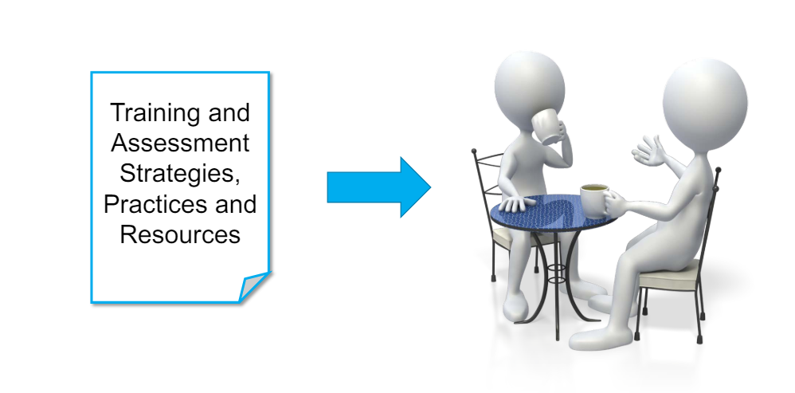

Relevance and Intention
What the Standards for RTOs 2015 say …
Standard 1
Clause 1.5 “The RTO’s training and assessment practices are relevant to the needs of industry and informed by industry engagement.”
Informing relevance during initial development
Informing to maintain continued industry relevance
Notes:
Referencing current standards …
What is the intention of the act of engaging and consulting with industry representatives?

Slide 14
Relevance and intention
Revised Standards for RTOs states …
Clause 1.2: - Quality Area – Training and Assessment
The RTO demonstrates:
how it identifies relevant industry, employer and/or community representatives and seeks meaningful advice and feedback from those representatives
it uses the advice and feedback to inform changes to training and assessment strategies and practices
training reflects current industry practice.
Notes:
Taking a look into the revised Standards ….
Nothing has changed except there are more defined criteria around the HOW and what we do with the outcomes from our practices to ensure continual current industry practice.

Slide 15
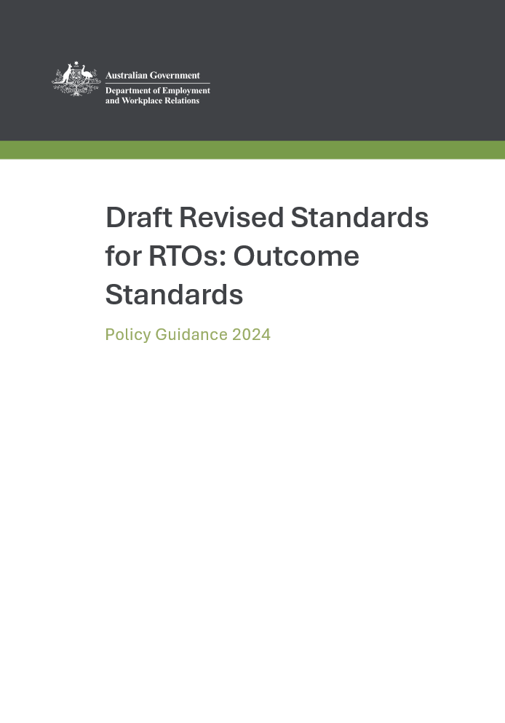
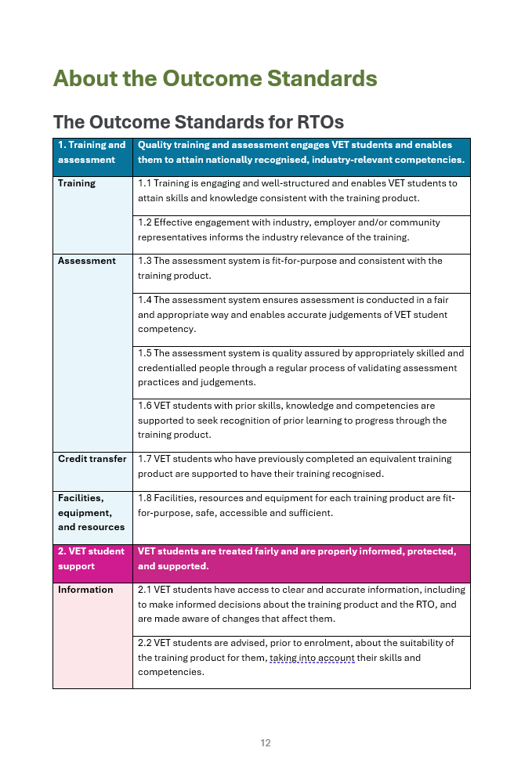
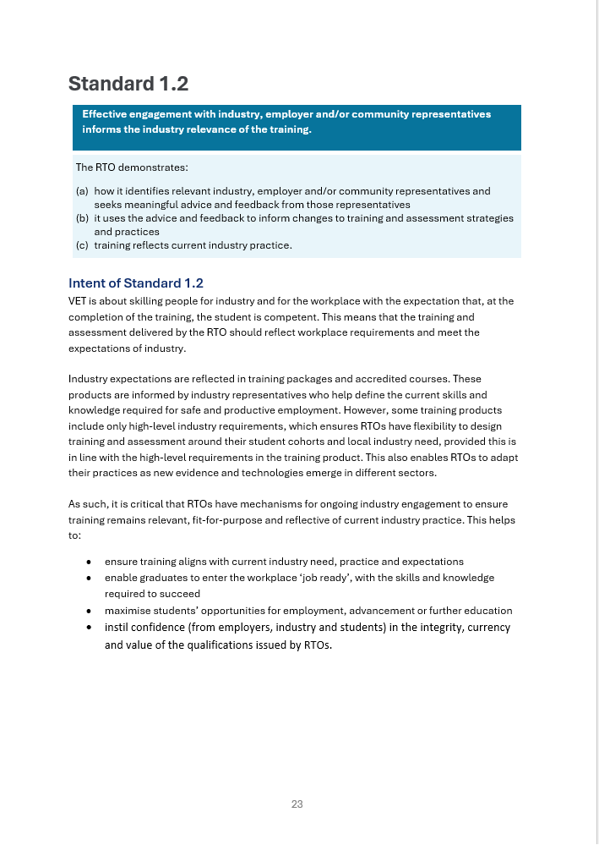
Informing Industry Relevant Resources
Revised Standards for RTOs Policy Guide states …
Clause 1.2 Intent:
“VET is about skilling people for industry …”
“… training and assessment delivered by the RTO should reflect workplace requirements and meet the expectations of industry.”
“It is critical that RTOs have mechanisms for ongoing industry engagement to ensure training remains relevant, fit-for-purpose and reflective of current industry practice.”
Notes:
Taking a look at the Policy Guide supporting these revised Standards it says …
I highlight the word critical here because I am mostly familiar with that being a compliance outcome. A critical non-compliance commonly results in suspension of delivery or even registration therefore, this guideline here is not to be ignored or referenced lightly. It is CRITICAL that RTOs HAVE MECHANISMS for ONGOING INDUSTRY ENGAGEMENT to ensure that training remains RELEVANT.

Slide 16
What the ‘OLD’ Standards say
Standards for NVR Registered Training Organisations 2012
SNR 4.2/15.2 Strategies for training and assessment meet the requirements of the relevant Training Package or VET accredited course and have been developed through effective consultation with industry.
SNR 4.3/15.3 Staff, facilities, equipment, and training and assessment materials to be used by the applicant meet the requirements of the Training Package or VET accredited course and the applicant’s own training and assessment strategies and are developed through effective consultation with industry.
Standards for NVR Registered Training Organisations 2012
Notes:
We may react to this and think well, oh dear, we do have to put something new in place. Well, not really. If you find yourself in that position then you haven’t really been doing what the Standards required all along.
Looking back at previously Standards and Frameworks ….
NVR 2012 says ….

Slide 17
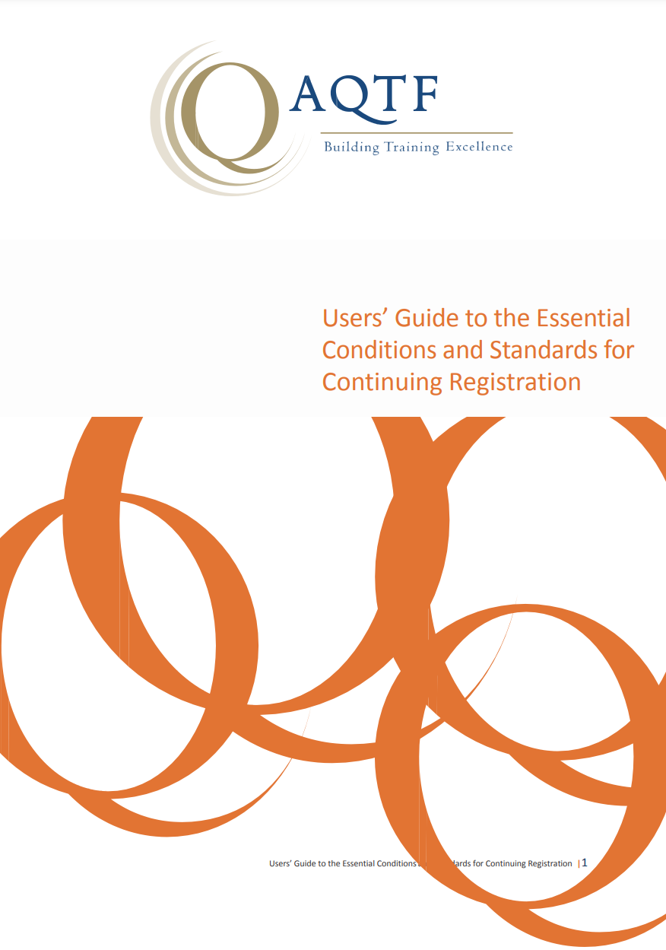
What the ‘OLD’ Standards say
AQTF Essential Standards and Conditions for Continuing Registration – June 2010
Standard 1.2: Strategies for training and assessment meet the requirements of the relevant Training Package or accredited course and are developed in consultation with industry.
User Guide:
Intent: All training and assessment strategies meet the requirements of the Training Package or accredited course. All training and assessment strategies are clearly informed by industry consultation and are systematically reviewed.
AQTF Essential Conditions and Standards for Continuing Registration – User Guide
Notes:
Taking ourselves even further back to the AQTF from 2010.

Slide 18
Informing relevance through validation
What the Standards for RTOs 2015 (Glossary) say
“Validation is the quality review of the assessment process. Validation involves checking that the assessment tool/s produce/s valid, reliable, sufficient, current and authentic evidence to enable reasonable judgements to be made. It includes reviewing a statistically valid sample of the assessments and making recommendations for future improvements to the assessment tool, process and/or outcomes and acting upon such recommendations.”
Notes:
Looking at the meaning behind ‘validation’ ….
There is no reference to ‘industry validation’ in the Standards. Validating is specifically aligned to assessment judgements and practices applied by the RTO.

Slide 19
What does the Regulator say?
Validators and ‘industry relevance’ requirements:
“Validation helps ensure that your RTO’s training and assessment practices are relevant to the needs of industry.
People who have current skills, knowledge and experience in the vocational area can provide input on:
The industry relevance of the context and conditions of the assessment
The industry relevance of the resources used during assessment
The tasks the learner completed, and
The judgements made by the assessor.
People who are vocationally competent will either:
Hold competency in the training product being validated, or
Be able to demonstrate they have skills and knowledge equivalent to the requirements of the training product.”
Fact Sheet – Conducting Validation, Australian Skills Quality Authority
Notes:
The Regulator, being the Australia Skills Quality Authority (ASQA).
It is simply about RTOs ensuring, and having systems in place that assure themselves that their training and assessment practices and resources are RELEVANT TO INDUSTRY TODAY.
We must be mindful of the purpose behind engagement and the outcomes we seek whilst engaging.

Slide 20
Engaging with industry for validation purposes
What the Standards for RTOs 2015 say
Standard 1
Clause 1.11 “…..systematic validation of an RTO’s assessment practices and judgements is undertaken by one or more persons
….who collectively have:….
Vocational competencies and current industry skills relevant to the assessment being validated
Current knowledge and skills in vocational teaching and learning
Training and assessment credential specified by the current Standards
This clause goes on to say that “Industry experts may be involved in validation to ensure there is a combination of expertise…”
Notes:
Sticking with validation, this is a process were our industry representatives inform our assessment practices during the process of validation.
RTOs must be assured that the industry representatives they are working with for this purpose hold or can demonstrate equivalence to the units of competency being validated.

Slide 21

Engaging industry in validation practices
VET T&A credential (TAE)
VET T&A currency
(Lead Validator)
Vocational competence and currency
(industry representative)
Vocational competence and currency
(industry representative)
Revised Standards for RTOs: - Quality Area “Training and Assessment”
Clause 1.5: The assessment system is quality assured by appropriate skilled and credentialled people through a regular process of validating assessment practices and judgements.
Notes:
When pulling together our validation team that comprises of industry experts it should look a little like this …
Our lead validator holds a TAE so they are fully aware of how to validate against the Principles of Assessment and Rules of Evidence.
Our industry experts ‘inform’ the validation process by reviewing the assessment tasks and their relevance to industry. In turn they can also look at assessment work produced by learners and ascertain the relevance to the task and in line with industry requirements today.
By combining our TAE experts with our industry experts the RTO is ensuring its assessment system is quality assured by appropriate skilled and credentialed people.

Slide 22
VET Workforce
Revised Standards Policy Guide (Clause 1.5): - Quality Area “Training and Assessment”
Engaging the right people to conduct validation and identify required changes to an RTO’s assessment system ensures the assessment system is informed by a deep understanding of VET and current industry practice and ensures objective opportunities for improvements are identified.
INFORMING
During the RTO’s development of its training and assessment practices and resources
VALIDATING
Providing input as part of a validation team
This is NOT validation
This is ‘informing’ validation of practices from an industry perspective
The intent behind the Revised Standards for RTOs is to introduce clearer quality controls around the use of industry experts. – Quality Area: VET Workforce.
Notes:
As we are speaking of the relevant personnel involved, let’s take a look at the focus of the VET Workforce and how this is referenced in the policy guide supporting the revised Standards for RTOs.
Clause 1.5 under the quality area ‘training and assessment’ states: ….
READ
Discuss Informing vs Validating again.
Round up with the intent from the VET Workforce Quality Area.

Slide 23
What are we informing exactly?
Let’s bring this back to the current Standards for RTOs…
Standard 1
Clause 1.6 “The RTO implements a range of strategies for industry engagement and systematically uses the outcome of that industry engagement to ensure the industry relevance of:
its training and assessment strategies, practices and resources; and
the current industry skills of its trainers and assessors”
Notes:
Bringing this back to the requirements of the current Standards ….
READ
So what does this mean?

Slide 24
The Training and Assessment Strategy
Training product
Core and elective components
Target group
Mode of delivery
Entry requirements
Duration and scheduling
Assessment resources, methods and timing
Learning resources
Human resources
Physical resources
Training and Assessment Strategy (TAS)
Training Product
Student Cohort
Notes:
We have our training and assessment strategy …. The TAS.
The TAS represents the Learning and Assessment arrangements and resources for a given program and for a given student cohort.
When considering WHAT RESOURCES an industry representative may ‘inform’ there are assessment resources, learning resources, human resources and physical resources.

Slide 25
The Resources (FOUR key resource areas)
Learning Resources
Engaging with Industry to inform relevance
Training and assessment practices and resources are relevant to industry today
Assessment Resources
Physical Resources
Physical resources and environment are sufficient and represent today’s relevant industry standards
Human Resources
Trainers and assessors have relevant and current industry skills
Notes:
In each instance what we want to know is if these resources and their associated practices are RELEVANT TO INDUSTRY TODAY.

Slide 26
Learning and Assessment Resources
LEARNING CONTEXT
Ensuring the topic content being delivered provides learners with opportunities to learn current industry relevant skills and knowledge
Observable Behaviours
Practical Application
ASSESSMENT METHODS
Ensuring that the methods of assessment applied adequately reflect industry relevant skills and knowledge.
Notes:
Breaking this down, for our learning context we are asking our representatives to consider the practical application (skills and knowledge) of what we are teaching. What are our learners being taught? Is this in line with what is applied in a practical context in the workplace?
For our assessment methods, we are asking our representatives to consider the techniques we are using across our assessment practices. E.g., observation of performance, and the industry relevance of the assessment activities being performed.

Slide 27
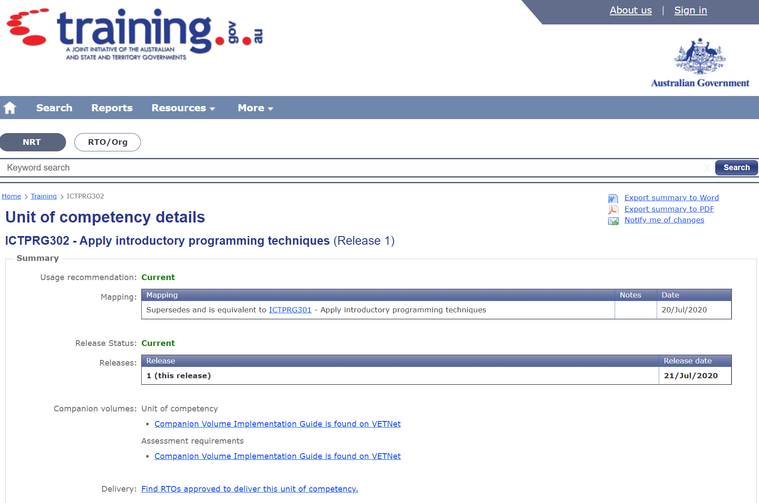
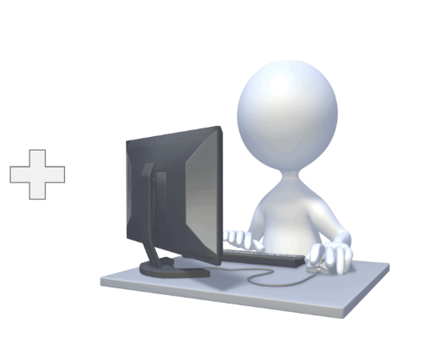
Physical Resources
Notes:
When we consider the physical resources, we also consider the industry relevance of the environment in which our learners are learning and being assessed.
There are two guides we refer to here: the training package and being ‘informed’ by industry representatives.
For instance, if we take this unit of competency ICTPRG302 Apply introductory programming techniques …. NEXT SLIDE.

Slide 28
Physical Resources
Assessment Conditions
“Gather evidence to demonstrate consistent performance in conditions that are safe and replicate the workplace.
Noise levels, production flow, interruptions and time variances must be typical of those experienced in the programming and software development industry, and include access to:
The requirement documents
The site documents
Software development tools currently used in industry, such as a compiler
An independent development environment (IDE)”
How do YOU know?
How are you INFORMED?
Notes:
The assessment conditions give us some physical resource guidance within the Assessment Conditions ….
How do you know?
How are you informed?
So that which is stated within the assessment conditions is a direction however, there is no context. How do you acquire and confirm that context and its relevance to industry?

Slide 29

Physical Resources
Your Skills and Knowledge
Industry Currency and Relevance
In this instance, engaging with an industry representative may enable you to:
SEE the workplace or be provided with VISUAL EVIDENCE
SIGHT document samples and acquire an AWARENESS of their contents and requirements
Receive ADVICE on software tools (e.g. what compilers?) and the independent development environment.
Notes:
You see, we have YOUR skills and knowledge because you either hold the competency or can demonstrate competence yourself, however, you need that ongoing currency and relevance aspect to ensure that what you are training and assessing is also representing what industry requires today.
The ways in which we can move forward with our physical resource consultations are ….
SEE the workplace - Visual Evidence
SIGHT documents – Awareness
Receive ADVICE on latest tools.

Slide 30
Human Resources
What the Standards for RTOs 2015 say
Standard 1
Clause 1.13b “The RTO’s training and assessment is delivered only by persons who have current industry skills directly relevant to the training and assessment being provided.”
Trainers and Assessors AND individuals training under supervision
Revised Standards for RTOs (Clause 3.3): - Quality Area “VET Workforce”
The RTO demonstrates:
each person delivering training and assessment:
  has industry competencies, skills and knowledge that are relevant to, and at least to the level of, the training product being delivered and/or assessed
  maintains an understanding of current industry practices
Notes:
Speaking of YOU … the trainer and assessor, we also need to BE INFORMED as the Human Resource for the program.
The current Standards required trainers and assessors to HAVE current industry skills which are DIRECTLY RELEVANT to the INFORMED training and assessment being provided.
The newly revised standards iterate this same requirement but include this … MAINTAINS AN UNDERSTANDING OF CURRENT INDUSTRY PRACTICES.
AGAIN … How Do You Know? How will you maintain that understanding. So, we don’t just attain the understanding. We maintain the understanding.

Slide 31
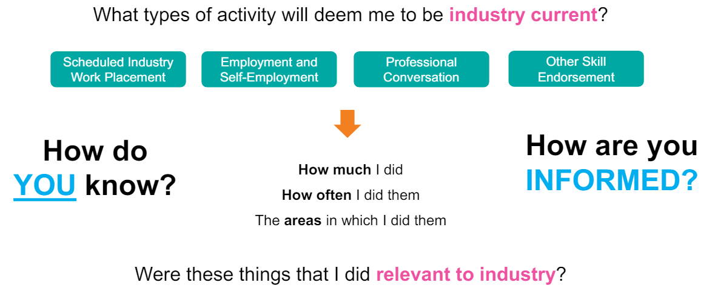
Human Resources
Notes:
Consider the RELEVANT types of activity that can assist you in maintaining your industry currency and understanding of current practices.
RECORD THIS!!
How much of an activity did you do?
How often did you do this?
What units of competency or components of units of competency did this activity cover? What was the relevance?
Were there any specific outcomes and actions that you need to follow up on or do more of as a result?
MAKE EVERY ACTIVITY HAVE A MEANING AND ENABLE YOU TO MAINTAIN AWARENESS ACROSS ALL IDENTIFIED GAPS IN YOUR CURRENCY.

Slide 32
Engagement Strategies

Slide 33

Industry Engagement
Strategies
Standards for RTOs 2015, Glossary
Industry engagement, for the purposes of Clauses 1.5 & 1.6, may include, but is not limited to, strategies such as:
partnering with local employers, regional/national businesses, relevant industry bodies and/or enterprise RTOs;
involving employer nominees in industry advisory committees and/or reference groups;
embedding staff within enterprises;
networking in an ongoing way with industry networks, peak bodies and/or employers;
developing networks of relevant employers and industry representatives to participate in assessment validation; and
exchanging knowledge, staff, and/or resources with employers, networks and industry bodies.
Notes:
When we consider strategies for engagement, you may have one or two things in your mind or that you already do.
Referring back to the current Standards for RTOs and its Glossary ….
READ.

Slide 34
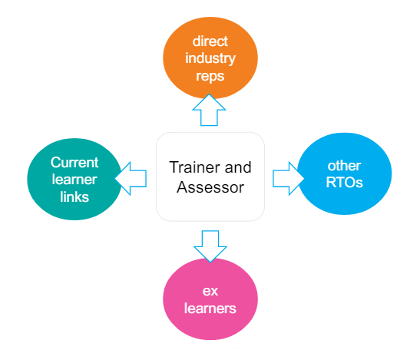
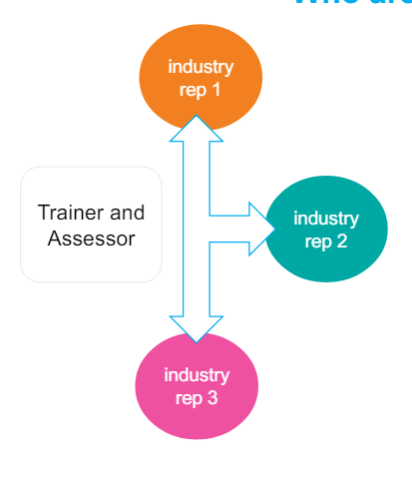
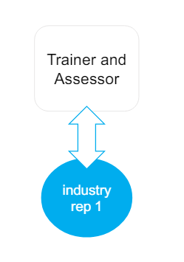
Who are our industry representatives?
Strategies
Notes:
Where do these industry representatives come from and how do I engage?
Capitalising on a good relationship with a particular organisation
Building an ongoing relationship with a particular expert representatives
Expanding your network of available representatives – direct industry reps (as in Fig 1), shared rep opportunities with other RTOs or using their qualified vocationally competent and current trainers, ex VET students who now work in the industry, current VET students who already work within the industry.

Slide 35



Where do we engage?
Strategies
How do we know when enough is enough?
Notes:
In the past there has been a sort of ‘formal vs informal’ range of engagement activities.
With the revised Standards, it is important to move away from this and make as many engagement activities ‘meaningful’ and ‘relevant’ and with an aligned purpose that is then recorded and acted upon so the RTO can show HOW it is engaging with industry SPECIFICALLY to maintain industry relevance across its training and assessment practices and resources.
So … we have our purpose, our reason for engaging … we have our people, our industry representatives in place, we have decided on our location(s) and also what we are going to do with the outcomes from the engagement.
How do we know when enough is enough?

Slide 36
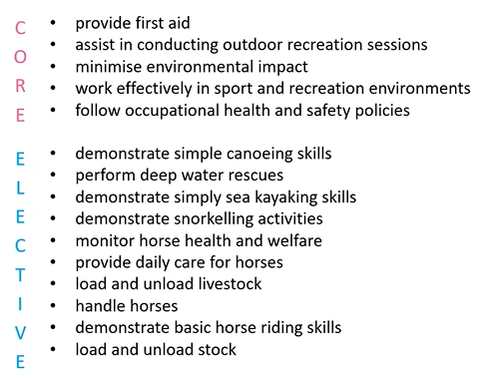
Industry Engagement
Certificate II in Outdoor Recreation
C
O
R
E
Assist in conducting recreation sessions
Minimise environmental impact
Maintain sport, fitness and recreation industry knowledge
Participate in workplace health and safety
Provide first aid
Perform basic water rescues
Paddle a craft using fundamental skills
Paddle a sea kayak in enclosed waters
Ride personal watercraft in smooth water conditions
Handle horses
Ride horses using fundamental skills
E
L
E
C
T
I
V
E
Notes:
It should come down to the product itself.
What are you being informed about? What was the purpose?
Let’s say we wish to engage with industry to maintain industry relevant practices and resources across our training and assessment for the CII in Outdoor Recreation.
Let’s unpack the units of competency here in this example ….

Slide 37

Industry Engagement
Certificate II in Outdoor Recreation
C
O
R
E
Assist in conducting recreation sessions
Minimise environmental impact
Maintain sport, fitness and recreation industry knowledge
Participate in workplace health and safety
Provide first aid
Perform basic water rescues
Paddle a craft using fundamental skills
Paddle a sea kayak in enclosed waters
Ride personal watercraft in smooth water conditions
Handle horses
Ride horses using fundamental skills
E
L
E
C
T
I
V
E
Notes:
We have a number of units pertaining to water skills.
So, we are going to need a water skills guy to inform our practices and resources moving forward.

Slide 38
Industry Engagement
Certificate II in Outdoor Recreation
C
O
R
E
Assist in conducting recreation sessions
Minimise environmental impact
Maintain sport, fitness and recreation industry knowledge
Participate in workplace health and safety
Provide first aid
Perform basic water rescues
Paddle a craft using fundamental skills
Paddle a sea kayak in enclosed waters
Ride personal watercraft in smooth water conditions
Handle horses
Ride horses using fundamental skills
E
L
E
C
T
I
V
E
Notes:
And may our water guy can cover some of our other core units aswell.

Slide 39

Industry Engagement
Certificate II in Outdoor Recreation
C
O
R
E
Assist in conducting recreation sessions
Minimise environmental impact
Maintain sport, fitness and recreation industry knowledge
Participate in workplace health and safety
Provide first aid
Perform basic water rescues
Paddle a craft using fundamental skills
Paddle a sea kayak in enclosed waters
Ride personal watercraft in smooth water conditions
Handle horses
Ride horses using fundamental skills
E
L
E
C
T
I
V
E
Notes:
But then what about these ‘horse’ units?
We will need a horse guy to inform us on this one as our water guy isn’t really going to know much about these.

Slide 40

Industry Engagement
Certificate II in Outdoor Recreation
C
O
R
E
Assist in conducting recreation sessions
Minimise environmental impact
Maintain sport, fitness and recreation industry knowledge
Participate in workplace health and safety
Provide first aid
Perform basic water rescues
Paddle a craft using fundamental skills
Paddle a sea kayak in enclosed waters
Ride personal watercraft in smooth water conditions
Handle horses
Ride horses using fundamental skills
E
L
E
C
T
I
V
E
Notes:
Then we have our provide first aid and we may need an entirely different industry representative to inform the relevance of that one.

Slide 41
Industry Engagement
Certificate II in Outdoor Recreation
C
O
R
E
Assist in conducting recreation sessions
Minimise environmental impact
Maintain sport, fitness and recreation industry knowledge
Participate in workplace health and safety
Provide first aid
Perform basic water rescues
Paddle a craft using fundamental skills
Paddle a sea kayak in enclosed waters
Ride personal watercraft in smooth water conditions
Handle horses
Ride horses using fundamental skills
E
L
E
C
T
I
V
E
Notes:
Actually, they may also be able to cover another unit or two given their expertise.
And, whilst we are at it, we may also be delivering other qualifications that also include units such as first aid or workplace health and safety, so our first aid guy may be engaged to inform across multiple qualifications.

Slide 42
Industry Engagement
Strategies
Industry / Field / Topic Area
Cluster units of competency that represent similar industry fields or subject topic areas, such as the water sports in the given Outdoor Recreation example.
Skills and Knowledge of Industry Representative
Ensure units of competency that represent similar industry fields or subject topic areas, such as the water sports in the given Outdoor Recreation example are aligned to the skills and knowledge of the industry representative.
Scheduling and Arrangements
Schedule engagements to enable systematic use of outcomes. Factor in efficiency where possible e.g., use one representative to cover similar fields across multiple qualifications.

Slide 43
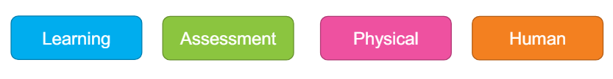
Industry Engagement
Strategies
Have you engaged with industry when developing your training and assessment strategies and practices?
BECOME INFORMED
How many industry representatives have you engaged with and for what purpose?
RANGE OF STRATEGIES
Has sufficient feedback been sought to inform the industry relevance of each of the 4 resource areas pertaining to your training products?

Slide 44
Engaging with
Industry Representatives

Slide 45
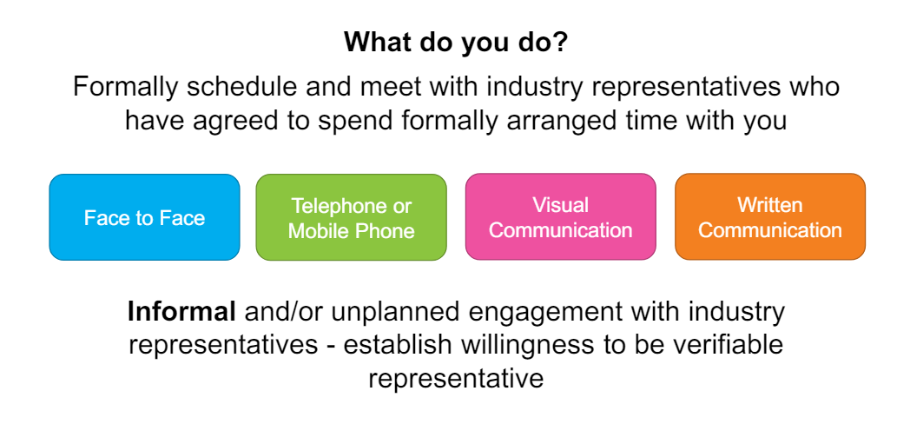
Preparation and engagement

Slide 46
Preparation and engagement
Can you construct some directed questions to represent
what you need to know?
learning
assessment
physical
human
This is the context of learning and topic areas I am training my learners to acquire skills and knowledge in.
Are these areas relevant to industry today?
These are the projects & tasks my learners are undertaking & completing for assessment, & the assessment methods being applied.
Are the requirements & methods used relevant to industry today?
These are the physical resources &
this is the assessment environment that my learners are provided with to use & to support their learning & assessment.
Are these relevant to industry today?
This is me, my qualifications and my recent industry & PD activities.
Am I relevant to industry today?
Notes:
Ger YOURSELF prepared.
What is it you need to know?

Slide 47
Using Engagement
Outcomes

Slide 48





Using Engagement Outcomes
Documentation
1. Details of the qualification, or cluster of units, or single unit of competency
2. Verifiable details of the industry representative(s) engaged
5. The actions you, in accordance with the RTO’s procedures, are implementing to ensure your training and assessment strategies &
practices are industry relevant
3. The resource area discussed (learning, assessment, physical or human)
4. The responses to the questions asked and recommendations where provided
The Revised Standards for RTOs states that the RTO must demonstrate that its system includes methods for collecting and reviewing data and feedback, including that provided by industry.
Notes:
Being informed DOESN’T STOP THERE.
The revised Standards state that the RTO must demonstrate methods for collecting and reviewing feedback including that provided by industry.
This is NOT to say that we must do all they advise. This is for us to consider what they have informed us of and apply this as relevant to our student cohorts. But we must review and consider what and how we have been informed and decide for ourselves what actions to take to maintain industry relevance.

Slide 49

Notes:
The key items here to note are …. Industry are not validating our practices and resources, they are informing us both before and during our training and assessment delivery.
It is an ongoing collaborative exercise.
As an auditor and VET consultant, over the years I have seen many wonderful collaboration strategies and engagement practices that seem to happen completely ad hoc, without planning and without purpose and certainly NOT documented. This is a shame because the practice is happening, but it isn’t guided or managed effectively by the RTO.
Consider how the RTO is supposed to show evidence of its own ongoing application to this area of compliance and quality assurance if it doesn’t approach this more systematically and with purpose?
And that includes the documentation both in preparation, outcome and applied improvements.
It has always been the requirement to do this, the newly revised Standards are now just stating this more clearly for our understanding.
For most of you it is either now time to adopt some new practices and strategies, or its time to evidence more thoroughly what you already do well. ☺

Slide 50
WHAT WE HAVE COVERED…..
Informing Industry Relevant Resources
01
Engagement Strategies
02
Preparing Targeted Questions
03
Using Engagement Outcomes
04

Slide 51


Slide 52
WITHIN 48 HOURS, YOU WILL RECEIVE AN EMAIL INCLUDING:
A Statement of Attendance
A link to event feedback survey
Access to the WMV recording of the webinar
PDF copy of the PowerPoint
PDF transcript of Chat Q&A
Additional supporting resources

Slide 53


Slide 54
We really hope you enjoyed engaging with Melanie Alexandra for your webinar today.
If you have any queries or feedback relating to today’s topic, or any general questions regarding your role within the VET sector, do not hesitate to contact the team at Velg Training.
Phone: 0411 174 548
Email: vetexcel@consultant.com
LinkedIn: Melanie Alexandra (VETExcel)

