Slide 1
YOUR WEBINAR WILL BEGIN SHORTLY
audio tests may occur during this period
Notes:
Audio tests conducted by Velg Training 15mins & 10mins prior to the start time

Slide 2

RAISE YOUR HAND IF YOU CAN HEAR ME
(audio test)
Notes:
Final audio test conducted by Velg Training approximately 3-5mins prior to the start time

Slide 3


NAVIGATING ZOOM

Slide 4
YOUR WEBINAR WILL BEGIN SHORTLY
Notes:
Velg Training will begin the presentation (and recording via Zoom) on this slide

Slide 5

ACKNOWLEDGEMENT OF COUNTRY
Source: https://outdoorsqueensland.com.au
Notes:
l

Slide 6
Changes in the VET Sector and
What They Mean to Me as a Manager
David Garner

Slide 7

ABOUT: David Garner
David is the Principal Consultant at [consult dg] and provides advice, development and research to the VET sector. He has worked in a variety of compliance related roles for over 15 years. He also currently works in staff roles for two RTOs delivering a range of courses to overseas students in Sydney, Melbourne and Perth.
As the General Manager Regulatory Operations for the Australian Skills Quality Authority, David was responsible for implementing ASQA’s regulatory strategy nationally.
David was also Director, Training Quality, in the Queensland Department of Education and Training. Prior to joining the Queensland department in 2005, David worked in and managed training providers for many years. David also has been active in sports administration for over 30 years.
Phone: 0411 045 136
Email: dg@consultdg.com.au
Website: https://www.consultdg.com.au/

Slide 8
POLL…
WHO’S ONLINE TODAY?
Notes:
(optional) – please advise Velg Training if you would like to include this Poll as part of the introduction to your presentation:
VELG Poll - Who's online today?
1. CEO/RTO Owner
2. RTO/Compliance Manager
3. Trainer/Assessor
4. Consultant
5. Other

Slide 9

Changes in the VET Sector
What do they mean for me as a manager?

Slide 10
What we’ll talk about
ESOS Framework reform
VET Data Streamlining
Industry Engagement reform
Qualifications reform
Quality reform
What is driving VET reform?
What should I do now?
AQF Review
ASQA’s Regulatory Approach

Slide 11
POLL
How familiar would you say you are with the
current reforms in the VET Sector?
Notes:
I’m all over it! As up to date as I can be
I’ve got a pretty good understanding of what’s happening
I’m a little vague on the details
I’ve got lots to catch up on
Reforms? What reforms?

Slide 12
ESOS Framework reform

Slide 13
ESOS Framework Reform
A review of the Education Services for Overseas Students Act 2000 and associated instruments was announced in February 2022
The review was intended to respond to the Australian Strategy for International Education 2021-2030, released in November 2021
Outcomes of the review were expected to presented to the Minister in mid-2022
No outcomes have as yet been announced and consultation is on-going.
https://www.education.gov.au/esos-framework/resources/education-services-overseas-students-esos-review-2022-discussion-paper

Slide 14
ESOS Framework Reform
Consultation for the review has focused on the following areas:
Percentage of a course able to be delivered on-line
  Currently, no more than one third of units in a course can be delivered on-line, although there were relaxations on this during the COVID pandemic
Behaviour of overseas education agents
  Particularly the lack of transparency in matters such as commissions paid to agents

Slide 15
ESOS Framework Reform
Consultation for the review has focused on the following areas:
Course transfers
  There is concern about the number of students transferring courses soon after arriving in Australia, particularly from higher education to VET courses
  Providers are restricted from enrolling overseas students within six months of commencing their ‘principal course’ at another provider
Written agreements
  This is considering whether written agreements with students should be more standardised to improve understanding and transparency.

Slide 16
VET Sector Reform

Slide 17
What is driving VET reform?
National Skills Agreement agreed by Skills Ministers and endorsed by National Cabinet in August 2022, intended to:
Provide industries with the skilled workers they need
Support providers to deliver quality education and training
Ensure all Australians have access to the education, training and support they need
Ensure no Australians are left behind as the economy transitions
Support informed decision-making
Pursue greater national consistency.
https://www.dewr.gov.au/skills-reform/skills-reform-priorities/national-skills-agreement-vision-and-principles

Slide 18
VET Data Streamlining Program
A partnership between Commonwealth, state and territory authorities and NCVER to implement:
A new VET Information Standard to replace AVETMISS 8.0
A new Student and Training Activity Reporting System (STARS) changing how RTOs will validate and submit data, which can be integrated with student management systems
Sector-wide, consistent reporting timeframes, including progressive reporting for all providers.
https://www.dewr.gov.au/skills-reform/vet-data-streamlining-program

Slide 19
VET Data Streamlining Program
Proposed benefits:
More efficient data validation and submission
Reduced duplication
Up-to-date USI transcripts
Supporting providers to manage data as they go
Improved evidence-based decision making.
Consultation has been undertaken with 702 RTOs in 2022, with results published in March 2023
Some providers may transition to new arrangements from mid-2024, others over following years.
https://www.dewr.gov.au/skills-reform/resources/registered-training-providers-experiences-vet-data-reporting-national-survey-findings

Slide 20
TYPE INTO THE CHAT
How do you feel about the new arrangements for VET Data?

Slide 21
Industry Engagement reform
Jobs and Skills Councils (JSCs) have been established to replace the Industry Reference Committees and Skills Service Organisations that formerly managed training package development
These councils are now operational, except the council responsible for building, construction and property, which will be operational shortly
The JSCs must include employer and union representation in governance and operations
TAE and FSK training packages have not been assigned to a JSC, but are being managed by an interim Technical Reference Group established by DEWR (TrainingProductQueries@dewr.gov.au)
https://www.dewr.gov.au/skills-reform/resources/new-industry-engagement-architecture

Slide 22
Industry engagement Reform
Assignment of training packages to JSCs:
Skills Insight www.skillsinsight.com.au
  Agribusiness
SkillsEQuipped www.skillsequipped.org.au
  Arts, Personal Services, Retail, Tourism and Hospitality
Powering Skills Organisation www.poweringskills.com.au
  Energy, Gas and Renewables
Future Skills Organisation www.futureskillsorganisation.com.au
  Finance, Technology and Business
Manufacturing Industry Skills Alliance www.manufacturingalliance.org.au/
  Manufacturing
Notes:
www.futureskillsorganisation.com.au

Slide 23
Industry engagement Reform
Assignment of training packages to JSCs:
Mining and Automotive Skills Alliance www.ausmasa.org.au/
  Mining and Automotive
Industry Skills Australia - www.industryskillsaustralia.org.au/
  Transport and Logistics
Public Skills Australia www.publicskillsaustralia.org.au/
  Public Safety and Government
HumanAbility www.humanability.com.au
  Early Educators, Health and Human Services
BuildSkills Australia (website under development)
  Building, Construction and Property

Slide 24
TYPE INTO THE CHAT
What are your thoughts on the implementation of new Jobs and Skills Councils?

Slide 25
Qualifications Reform
The VET qualifications system is believed to have become too complex and difficult to navigate, with:
  1,200 qualifications
  1,600 skill sets
  15,000 units of competency
  670 accredited short courses
This reform process ‘seeks to enhance the strengths of the existing VET system to ensure it is relevant to labour market needs and can keep pace with the challenges and opportunities facing the Australian labour market and economy’
Significant consultation with stakeholders occurred through late 2022 and early 2023 and draft new training package rules are expected to be announced by the end of 2023 for implementation commencing 2024
https://www.dewr.gov.au/skills-reform/vet-qualification-reform

Slide 26
Qualifications Reform
Consultation has focussed on testing a proposed architecture of:
Skills Standards describing the skills required for a particular job
Training and Assessment Requirements that provide guidance on training delivery and assessment
Completion Rules detailing the packaging into recognised qualifications and skill sets
Units of competency are expected to remain the key ‘building blocks’ of VET qualifications.

Slide 27
TYPE INTO THE CHAT
What do you believe are the benefits/challenges of changes to the architecture of training packages/qualifications/units of competency?

Slide 28
AQF REVIEW
Reviewed, awaiting action notification.
The Review of the Australian Qualifications Framework Final Report 2019 was completed and presented in 2019.
The Review proposed a comprehensive set of reforms and an implementation plan that would see a future AQF evolve to better perform its key functions, and to support and reflect ongoing change and innovation in qualification development and delivery.
There have been no subsequent changes related to this Review at this time.
https://www.dewr.gov.au/skills-reform/quality-reforms

Slide 29
Quality Reform
This reform program consists of two key components:
Blueprint for the VET Workforce
  There has been little communication with stakeholders on this, but the intent is to ensure long-term sustainability of the VET workforce
Revising the Standards for RTOs
  A consultation paper was released in October 2022, including proposed draft standards
  Consultation was undertaken with stakeholders in November 2022 – January 2023
  There has not been any further communication from DEWR, although ASQA staff have advised they expect the revised standards to be implemented ‘mid 2024’.
https://www.dewr.gov.au/skills-reform/quality-reforms

Slide 30
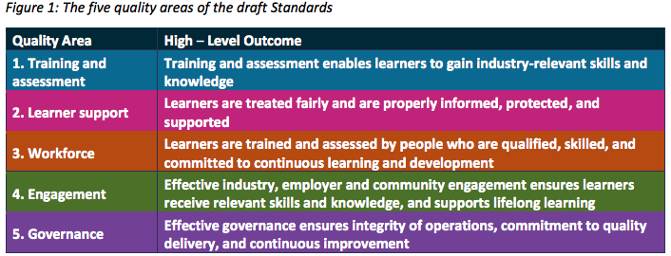
Quality Reform
The draft standards are ‘structured around outcomes’ and divided into five ‘quality areas’, with ‘an outcome statement for each area
https://www.dewr.gov.au/skills-reform/resources/draft-standards-rtos
https://www.dewr.gov.au/skills-reform/resources/draft-rto-standards-consultation-paper

Slide 31
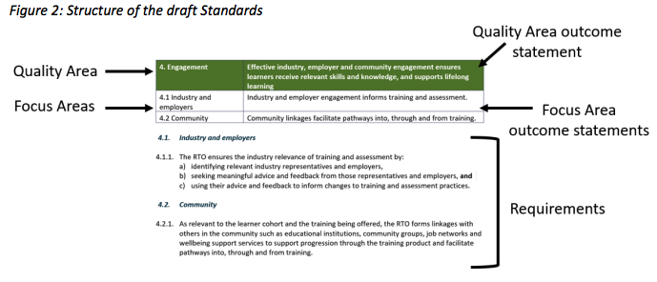
Quality Reform
Each of the five quality areas have a set of ‘focus areas’ and ‘requirements’ mapped to each focus area

Slide 32
Quality Reform
How are the draft standards different to the current set?
For the most part, the requirements are similar
There are some areas that are not yet settled, including parts of governance, third parties, fee protection and transition and these may separate from the standards themselves and be established as ‘compliance requirements’
Skills Ministers agreed in June 2023 to strengthen the fit and proper person requirements, so it is likely these will be changed
There are some proposed requirements that are new or significantly different to the existing standards, so let’s talk about those.

Slide 33
Quality Reform
Notable changes to proposed Standards for RTOs
1.2.4 Pre-validation of assessment tools occurs prior to use to ensure they are fit-for-purpose
2.2.1 Prior to enrolment …, the RTO reviews the existing skills and competencies of the learner, including their language, literacy, numeracy, and digital proficiency
2.2.4 Learners have reasonable access to trainers
Notes:
2.2.1 Prior to enrolment (or the commencement of training and assessment, whichever comes first), the RTO reviews the existing skills and competencies of the learner, including their language, literacy, numeracy, and digital proficiency, and provides advice about the appropriateness of the training product to meet their needs.
2.2.4. Learners have reasonable access to trainers and assessors, and receive timely responses to queries, so they are supported to progress through the training product.

Slide 34
Quality Reform
Notable changes to proposed Standards for RTOs
2.3.1 Learners have access to wellbeing support services
2.3.2 … support the delivery of culturally safe training and assessment for Aboriginal and Torres Strait Islander peoples
4.2.1 … the RTO forms linkages with others in the community such as educational institutions, community groups, job networks and wellbeing support services to support progression through the training product and facilitate pathways into, through and from training.
Notes:
2.3.1. Learners have access to wellbeing support services, with the services promoted or offered being informed by the needs of the learner cohort.
2.3.2. Policies and practices, including in relation to enrolment, training, and assessment, create equitable opportunity for achievement of training outcomes by all individuals, and:
are inclusive and recognise the diversity of learners,
ensure the safety of children and young people, and other vulnerable cohorts, and
support the delivery of culturally safe training and assessment for Aboriginal and Torres Strait Islander peoples, giving specific consideration to their recruitment, participation and completion.
4.2.1. As relevant to the learner cohort and the training being offered, the RTO forms linkages with others in the community such as educational institutions, community groups, job networks and wellbeing support services to support progression through the training product and facilitate pathways into, through and from training.

Slide 35
TYPE INTO THE CHAT
Does anything in the proposed Standards jump out at you as something of concern?

Slide 36
ASQA

Slide 37
ASQA
Regulatory approach focusses on:
treating the most significant risks facing the VET sector
responding to non-compliance early
educating providers to reduce risk
analysing intelligence to gain insights into provider conduct
consulting and sharing more information sector-wide to clarify what risk is
providing clear feedback and support for providers to encourage self-assurance
routine sector monitoring using random sampling rather than risk-based selection to ensure public confidence in the quality of VET

Slide 38
Raise your virtual hand
Has anyone online today been “performance assessed” (audited) under the new
approach?

Slide 39
ASQA
Performance Assessment
A sampling approach
This means to understand your performance they will:
usually look at some, but not all standards
sample evidence across your training products
The clauses and training products sampled as part of your performance assessment are known as the ‘scope’ of the assessment.

Slide 40
ASQA
Scope of Performance Assessment
Decided by reviewing:
enrolment and completion data
compliance history
current and past complaints
intelligence from other regulators and agencies
applications that will be considered as part of the performance assessment, where applicable.

Slide 41
ASQA
Performance Assessment Considerations
The performance assessment process considers 3 key questions:
Does your practice align with the requirements of the Standard?
Do you have a system for ensuring ongoing compliance with the Standard?
Do you regularly monitor, review and continuously improve (self-assure) to ensure compliance with the Standard?

Slide 42
All these changes!
What should I do?

Slide 43
What should I do?
Ensure you are subscribed to ASQA updates
Read your VELG newsletters
Review dewr.gov.au/skills-reform regularly
Any changes will be announced well ahead of time and major changes will include transition periods as well as opportunities to learn what the changes mean.
https://www.dewr.gov.au/skills-reform

Slide 44
What we talked about
ESOS Framework reform
VET Data Streamlining
Industry Engagement reform
Qualifications reform
Quality reform
What is driving VET reform?
What should I do now?
AQF Review
ASQA’s Regulatory Approach

Slide 45

ANY QUESTIONS?

Slide 46

WHAT HAPPENS NOW?
WITHIN 48 HOURS, YOU WILL RECEIVE AN EMAIL INCLUDING:
A Statement of Attendance
A link to event feedback survey
Access to the WMV recording of the webinar
PDF copy of the PowerPoint
PDF transcript of Chat Q&A
Additional supporting resources

Slide 47

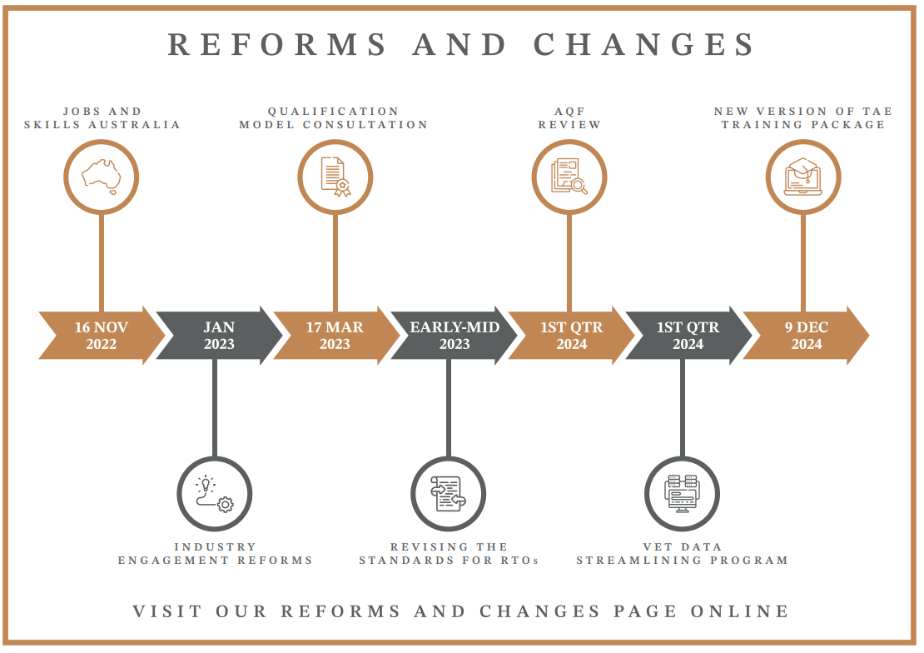
OUR GIFT TO YOU…
BONUS RESOURCES!
VET Reforms and changes interactive calendar
Notes:
As part of celebrating Velg Training’s 20th Birthday – we’ve got some bonus resources to give as our gift to you.
Velg Training is providing a VET Reforms and changes interactive calendar
It includes:
• A PDF that reflects the current status of and information about the reforms and changes coming to the sector; and
• A downloadable, interactive single-page timeline.
Simply click on the reform shortcut to be taken immediately to the latest information as it comes to hand. Both this document and the calendar are linked to our Reforms and Changes website page that will provide further information that is updated on a regular basis.
We hope these are of benefit to you ☺

Slide 48

UPCOMING EVENTS

Slide 49

Coming up
24-28 July is Focus Week: Assessment Tools and Practices
Click here

Slide 50
THANK YOU FOR YOUR COMPANY
We really hope you enjoyed engaging with David for your webinar today.
If you have any queries or feedback relating to today’s topic, or any general questions regarding your role within the VET sector, do not hesitate to contact the team at Velg Training.
Phone: 0411 045 136
Email: dg@consultdg.com.au
Website: https://www.consultdg.com.au/

Slide 51
CONTACT US
Velg Training
9 Froude Street
Banyo QLD 4014
P 07 3866 0888
E webinar@velgtraining.com
W velgtraining.com

