Slide 1
YOUR WEBINAR WILL BEGIN SHORTLY
audio tests may occur during this period

Slide 2


Slide 3
Breaking Down Assessing Competence
David Garner

Slide 4
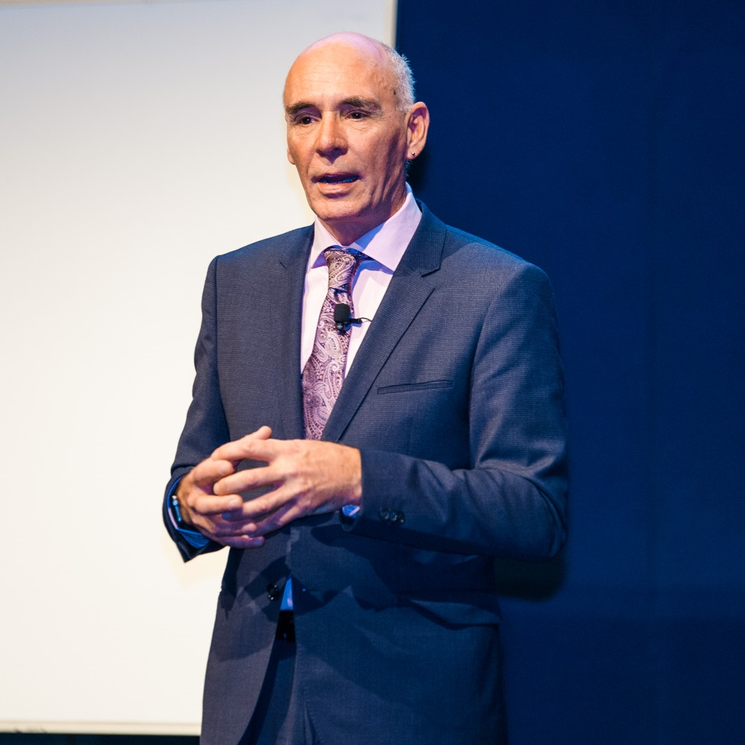
ABOUT: DAVID GARNER
David is the Principal Consultant at [consult dg] and provides advice, development and research to the VET Sector. He has worked in a variety of compliance related roles for over 15 years.
Most recently, as the General Manager Regulatory Operations for the Australian Skills Quality Authority, David was responsible for implementing ASQA’s regulatory strategy nationally, including monitoring compliance of providers and intending providers against the VET Quality and ESOS Framework.
David was previously Director, Training Quality, in the Queensland Department of Education and Training. Prior to joining the Queensland department in 2005, David worked in and managed training providers for many years. David has been active in sports administration for over 30 years and sat for many years on the board of the Queensland Fitness, Sport and Recreation Skills Alliance.
Phone: 0411 045 136
Email: dg@consultdg.com.au
Website: consultdg.com.au

Slide 5

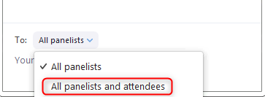
NAVIGATING ZOOM

Slide 6

RAISE YOUR HAND IF YOU CAN HEAR ME
(audio test)

Slide 7
POLL…
WHO’S ONLINE TODAY?

Slide 8
WEBINAR OVERVIEW
What to consider when preparing for assessment
How to gather quality evidence
Supporting the learner in the assessment process
Keys to making the assessment decision
Critical requirements of reporting and recording

Slide 9
What to consider when preparing for assessment

Slide 10
QUESTION…
Please type your response in the chat window
Do you regularly use a formal assessment plan?

Slide 11
WHAT IS AN ASSESSMENT PLAN?
Overall planning document specific to assessment
Link and align to the TAS

Slide 12
CONSIDERATIONS
Why
Who
What
When
Where
How
Assessment objectives
Who will be involved and their needs
Physical and HR resources
Timeframes
Location – Simulated? Workplace?
The assessment methods
Against what benchmark
How long
How many times
Procedures
Consultation
Notes:
Interpret assessment planning documentation and applicable organisational, legal and ethical requirements for conducting the assessment and confirm with the relevant people

Slide 13
POLL…
Who has the responsibility of ensuring unit coverage in assessment decisions?
Notes:
Who has the responsibility of ensuring unit coverage in assessment decisions?
Curriculum/Assessment Developer
RTO Manager
Curriculum Leader
Assessor

Slide 14

Who is making the assessment decision?
Who is ‘signing off’?
Notes:
Access and interpret units of competency that are to be used as benchmarks for assessment, and the nominated assessment tools, to confirm the requirements for the evidence to be collected

Slide 15
UNIT COVERAGE
Performance Criteria
Foundation Skills
Performance Evidence
Knowledge Evidence
Assessment Conditions

Slide 16
DOCUMENTATION
Unit of Competency
Assessment Requirements
Companion Volumes
Assessment Tools
Mapping Document
Notes:
Access and interpret units of competency that are to be used as benchmarks for assessment, and the nominated assessment tools, to confirm the requirements for the evidence to be collected

Slide 17
STUDENT INFORMATION
Student needs to understand the process – clear communication
Student needs to understand what they are being assessed on
Workplace assessment adds a layer of communication
Notes:
Conduct a candidate briefing and explain, discuss and agree on the details of the planned assessment
Arrange identified material and physical resource requirements

Slide 18
MATERIALS AND RESOURCES
Room bookings
Is a specialist room required? Commercial kitchen?
Physical equipment
Does plant and equipment need to be hired? Bobcat?
Technology
Do students need access to computers and the internet?
Travel
Is the assessment taking place in a location that requires bookings for accommodation, car hire, flights, etc?
Assessment Tools
Is the tool able to be accessed electronically or is there photocopying required?
Legislative and Licensing
Is there any documentation required for licensed outcomes?

Slide 19
How to gather quality evidence

Slide 20

Are your practices following the plan?
Notes:
Interpret assessment planning documentation and applicable organisational, legal and ethical requirements for conducting the assessment and confirm with the relevant people

Slide 21

UNPACK THE ASSESSMENT TOOLS
Context and conditions
Tasks to be administered to the student
Outline of the evidence to be gathered
Evidence criteria for judgement
Administration requirements
Recording requirements
Reporting requirements
Source: ASQA’s Guide to Developing Assessment Tools

Slide 22
TASKS TO BE ADMINISTERED
What the learner needs to:
Say
Do
Write
Create
Notes:
The instructions you provide to the student should outline the task(s) through which a learner can demonstrate competency. These instructions will prompt the learner to say, do, write or create something. The learner clearly needs to understand the tasks. If the learner reviews the tasks and needs to clarify the instructions or ask further questions, then the information provided is not valid or reliable. Well-designed assessment instructions minimise the variation between assessors

Slide 23
EVIDENCE OUTLINE
Observation
Observation Checklist
Guidance on:
What to include
How to submit
How to present
Observation
Live or Video
Observation
How to Submit Video
Notes:
As well as informing the learner of what they will do in the assessment, you will need to explain to them what evidence they need to provide in response to the tasks. If a learner is required to submit evidence, the instructions must include guidance on: • what to include as evidence • how to submit the evidence, and • how to present the evidence. If a learner is observed by an assessor, the outline of the evidence should clarify what the assessor will look for during the observation. An ‘observation checklist’ could be appropriate in this instance. You should also communicate to the learner if the observation is being recorded by audio or video

Slide 24
EVIDENCE CRITERIA
Assessment decision making rules
Evaluating evidence against the rules of evidence
Did the learner perform the standard required in the workplace?
Is there consistency and transferability of performance?
When using the criteria there needs to be consistency of judgements across assessors
There also needs to be consistency within one assessor’s judgements.
Notes:
The evidence criteria should not be open to interpretation. The criteria must provide sufficient clarity for assessment judgements to be consistent across a range of assessors and points in time. If your RTO has only one assessor, you must still develop evidence criteria to ensure consistency in that assessor’s judgements.
RULES OF EVIDENCE

Slide 25
QUESTION…
Please type your response in the chat window
Who can remember the four (4) principles of assessment?

Slide 26
PRINCIPLES OF ASSESSMENT
Valid
Fair
Reliable
Flexible

Slide 27
QUESTION…
Please type your response in the chat window
Who can remember the four (4) rules of evidence?

Slide 28
RULES OF EVIDENCE
Valid
Current
Authentic
Sufficient

Slide 29
Supporting the learner in the assessment process

Slide 30
QUESTION…
Please type your response in the chat window
What are some challenges you face in developing rapport with learners?

Slide 31

DEVELOPING RAPPORT WITH LEARNERS
Barriers
Online learning
No follow through with learners
Opportunities
Call where possible instead of email
Provide verbal feedback via audio or video recording
Engage in conversation
Demonstrate empathy
Maintain confidentiality
Limited contact
Lack of input to environment

Slide 32
REASONABLE ADJUSTMENT
Assessors must ensure that students are not disadvantaged because of cultural background, language, age, gender, religion or disability.
Assessors must still uphold the rigour and integrity of the unit of competency.
Notes:
Interpret assessment planning documentation and applicable organisational, legal and ethical requirements for conducting the assessment and confirm with the relevant people

Slide 33
SCENARIO…
Please type your response in the chat window
On the day of assessment, a critical piece of equipment is not working. It isn’t the students’ fault, so you decide to make a reasonable adjustment in the assessment to note that the students were unable to use the equipment due to the RTO’s failure.
DISCUSS

Slide 34
SCENARIO…
Please type your response in the chat window
A student notifies you a few days before their written assessment that they have broken their arm. They can still complete the assessment however they are going to need more time and access to a computer to type responses rather than write.
DISCUSS

Slide 35

POSSIBLE REASONABLE ADJUSTMENT
Additional time
Additional one-to-one support
Modified activities
Verbal or signed information instead of written
Electronic resources
Use of material in alternative formats
Using modified resources
Use of adaptive technologies
Use of alternative venues
Provision of personal support services, such as readers and interpreters

Slide 36
Keys to making the assessment decision

Slide 37
TYPES OF EVIDENCE
Direct
Indirect
Supplementary

Slide 38

SKILLS VS KNOWLEDGE
How much is enough?

Slide 39
POLL…
What do you look at to see that the student evidence aligns to in order to make a decision?
Notes:
What do you look at to see that the student evidence aligns to in order to make a decision?
The checklist
The task instructions
The unit of competency
The mapping document
All of the above

Slide 40
ASSESSOR GUIDES
Will differ depending on the type of task and the unit of competency/industry
Instructions should provide guidance for someone who hasn’t used the tool before
Need to ensure sufficient instructions to ensure consistency of judgements
Notes:
Use appropriate communication and interpersonal skills to develop a professional relationship with the candidate that reflects sensitivity to individual differences and enables two-way feedback
Make sure the environment is suitable for the assessment being conducted
Create a positive atmosphere and pay attention to the surroundings
Ensure that candidates are relaxed and not apprehensive
Greet the candidate, welcome them and establish rapport. Allow candidate time to settle in and feel comfortable.
Give a brief overview of the assessment process in terms that are easily understood
Advise candidates on the time allowed for the assessment
Invite candidates to ask questions
Advise candidates when they can begin the assessment task

Slide 41
Critical requirements of reporting and recording

Slide 42

RTO PROCEDURES ARE KEY
Refer to the policies and procedures of the RTO
Comply with instructions in the assessor guide
Complete all areas of the student assessment tool

Slide 43
POLL…
What result do you record on your individual assessment items?
Notes:
What result do you record on your individual assessment items?
Competent/Not Competent
Satisfactory/Not Satisfactory
Working Towards Competence – Yes/No

Slide 44
TERMINOLOGY
Competent
Not Competent
Satisfactory
Not Satisfactory
Demonstrated Yes
Demonstrated No

Slide 45
OVERALL JUDGEMENT
Observation
Written Questions
Competent
Culmination of all assessment for the unit

Slide 46
WHAT WE HAVE COVERED…
What to consider when preparing for assessment
How to gather quality evidence
Supporting the learner in the assessment process
Keys to making the assessment decision
Critical requirements of reporting and recording

Slide 47

ANY QUESTIONS?

Slide 48

WHAT HAPPENS NOW?
WITHIN 48 HOURS, YOU WILL RECEIVE AN EMAIL INCLUDING:
A Statement of Attendance
A link to event feedback survey
Access to the WMV recording of the webinar for three months
PDF copy of the PowerPoint
PDF transcript of Chat Q&A
BONUS RESOURCES
Preparation for Assessment Checklist (to assist in preparing the student for assessment)
Assessment Plan Template
Example Unit Assessment Summary Sheet

Slide 49
UPCOMING EVENTS
Tomorrow’s TAE PD Week webinars…
4 December @ 11am: Webinar
Currency, the Natural Outcome of Effectively Participating in Assessment Validation
4 December @ 1pm: Webinar
Enhancing Learning in the Workplace
*All webinar times are shown in AEST (QLD time)

Slide 50
CONTACT US
Velg Training
1/52 Jeffcott Street
Wavell Heights QLD 4012
P 07 3866 0888
E webinar@velgtraining.com
W velgtraining.com

Slide 51
THANK YOU FOR YOUR COMPANY
We really hope you enjoyed engaging with David for your webinar today.
If you have any queries or feedback relating to today’s topic, or any general questions regarding your role within the VET sector, do not hesitate to contact the team at Velg Training.
Phone: 0411 045 136
Email: dg@consultdg.com.au
Website: consultdg.com.au

