Slide 1
YOUR WEBINAR WILL BEGIN SHORTLY
audio tests may occur during this period

Slide 2


Slide 3
The DESIGN and DEVELOPMENT of Assessment Tools – Part 2
Melanie Alexandra

Slide 4

ABOUT: Melanie Alexandra
Melanie Alexandra has held a variety of roles across both the academic and vocational education sectors including that of Trainer and Assessor, Curriculum Manager, RTO Manager, Head of Faculty, Head of Quality Assurance, and Senior Lead Auditor.
Over the past decade Melanie has conducted hundreds of regulatory audits and registrations against the current legislated VET Quality Framework and now provides quality VET audit and compliance consulting services in support of Registered Training Organisations and providers of VET in Schools.
Phone: 07 3866 0888
Email: melanie@velgtraining.com.au
Website: www.velgtraining.com
LinkedIn: Melanie Alexandra

Slide 5

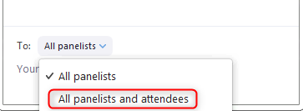
NAVIGATING ZOOM

Slide 6

RAISE YOUR HAND IF YOU CAN HEAR ME
(audio test)

Slide 7
POLL…
WHO’S ONLINE TODAY?

Slide 8
TAEASS502 Design and Develop Assessment Tools – Two Parts
Application: “Design and develop assessment tools used to guide the collection of quality evidence, including their application in formative, summative and recognition of prior learning (RPL) assessment.”
Part One (Yesterday)
Determine the focus of the assessment tool
Design the assessment tool
Part Two (Now)
Develop the assessment tool
Review and trial the assessment tool
Notes:
Time: ½ min
How we are addressing the unit components over two webinars.

Slide 9
WEBINAR OVERVIEW…
Design recap - what did we cover yesterday?
Storage, Retrieval and Version Control
Assessment Review and Trial Practices
Developing assessment tools and instruments
User Instructions
Application of Evidence Gathering Techniques
Notes:
Time: ½ min

Slide 10

Backward Design Model
What does a competent person look like?
“Begin with the end in mind”
Notes:
Time: ½ min

Slide 11
Backward Design Model
What does a competent person look like?
Backward Design Model | Identify desired results | Determine acceptable evidence that meet desired results | Plan assessment experiences and instruction
Your Design Process | Begin with the end in mind. What does that competent person look like? | Enable learner performance to represent that of a competent person | Develop activities that beget competent learner performance
The Evidence | Competent Person | Competent Assessment Judgement | Activity Instruction and representative Evidence Gathering Tools and Practices
Notes:
Time: 1 min

Slide 12
QUESTION…
Please type your response in the chat window
Having drafted the design of your assessment, what key issues do you face when beginning the development process?
Notes:
Time: 2 min
We are looking for:
A reason to capture evidence
Evidence that the student has displayed – the knowledge and skills required for a particular unit of competency
Evidence that the relevant skills were asked for
Evidence that the assessor has made a decision, irrespective of what that decision is.

Slide 13
Develop the Assessment Tool
Develop specific assessment instruments
Unit of Competency:
Performance criteria
Foundation skills
Performance evidence
Knowledge evidence
Assessment conditions
Evidence Gathering Tool
Observation Checklist
Satisfactory
Assessment Judgement
Competent
Not
Competent
Not Yet Satisfactory
Mapping
Project evidence
Includes instructions for students
WHAT THEY ARE TO DO (Observable behaviours)
Evidence Gathering Tool
Sample response to verbal questions
Satisfactory
Not Yet Satisfactory
Unit of Competency:
Performance criteria
Foundation skills
Performance evidence
Knowledge evidence
Assessment conditions
Satisfactory
Evidence Gathering Tool
Supplementary third party report
Assessment Judgement
Competent
Not
Competent
Not Yet Satisfactory
Evidence Gathering Tool
Product Checklist
Satisfactory
Project evidence
Includes instructions for students
WHAT THEY ARE TO SUBMIT
Not Yet Satisfactory
Unit of Competency:
Performance criteria
Foundation skills
Performance evidence
Knowledge evidence
Assessment conditions
Satisfactory
Evidence Gathering Tool
Portfolio Checklist
Assessment Judgement
Competent
Not
Competent
Not Yet Satisfactory
Evidence Gathering Tool
Sample responses to written work/questions
Satisfactory
Not Yet Satisfactory
Notes:
Time: 2 min
This is a graphical map of the process of developing assessment materials and tools.
Units
Projects and associated evidence gathering tools that result in a Satisfactory or Unsatisfactory outcome
Map these back to the units
Culmination of Satisfactory outcomes leads to a final assessment outcome of COMPETENT for the units of competency the assessment evidence is aligned to.

Slide 14
Develop the Assessment Tool
Develop specific assessment instruments
…. that meet the rules of evidence required
Rules of Evidence
Valid
Current
Authentic
Sufficient
Evidence collected must be evidence of what it claims to be evidence of, therefore, instruments must ENABLE the clear alignment of evidence to the criteria (decision making rules) being assessed AND the rules themselves must actually assess what they claim to assess.
Evidence collected must be ENOUGH to meet the sufficiency criteria e.g. product size/measurements, number of times performed, etc. If ANY of the other 3 rules e.g. Valid, Current, Authentic are NOT MET then evidence is NOT SUFFICIENT.
Evidence that EQUATES to practice conducted
1: in the ‘near or recent past’
2: within industry today
How do you ENSURE, without question, that this is ‘real’ and the work of the student?
For instance, online, blended assessment methods, two-fold approach, require secondary authentication practice, etc
Notes:
Time: 2 min
Understanding the Rules of Evidence

Slide 15


Develop the Assessment Tool
Develop specific assessment instruments
…. that meet the types of evidence required for the unit
What do I DO and what do I SUBMIT?
Just DO
Observable Performance and Knowledge
= Observable Behaviours, Verbal Questions/Interview, etc
Types
of
Evidence
DO and SUBMIT
Submitted evidence of Performance and Knowledge
= Product, Written Work, Written responses to written questions, etc
Notes:
Time: ½ min

Slide 16
Develop the Assessment Tool
Develop specific assessment instruments
…. that meet the types of evidence required for the unit
Unit:
BSBWHS332X Apply infection prevention and control procedures to own work activities
Application:
This unit describes the skills and knowledge required to undertake work activities in compliance with organisational procedures that prevent and control infection. It involves implementing standard and transmission-based precautions, identifying infection hazards, and assessing and responding to infection risks.
The unit applies to all workers required to undertake their activities in compliance with the infection prevention and control procedures in place in their workplace.
The skills in this unit must be applied in accordance with Commonwealth and State/Territory legislation, Australian/New Zealand standards and industry codes of practice.
Notes:
Time: 1 min
Let’s analyse A Unit of Competency

Slide 17
Develop the Assessment Tool
Develop specific assessment instruments
…. that meet the types of evidence required for the unit
Performance
Knowledge
Conditions/ Specifications
Mandatory Submission Requirement
Element | Performance Criteria
1. Prepare to undertake work activities in a manner than support infection prevention and control | 1.1 Identify job requirements
 | 1.2 Identify organisational infection prevention and control procedures relating to identified job requirements
 | 1.3 Identify infection hazards associated with work activities and environment and assess the risk according to organisational procedures
 | 1.4 Identify and implement infection prevention and control measures relating to identified hazards within scope of own role and responsibilities and according to organisational procedures
2. Undertake work activities in a manner that supports infection prevention and control | 2.1 Use resources and equipment according to organisational infection prevention and control procedures and manufacturer specifications
 | 2.2 Clean and maintain own work area according to organisational infection prevention and control procedures
 | 2.3 Respond to infection prevention and control hazards and non-compliance arising in the course of activities, within scope of own role or escalate to required personnel
 | 2.4 Respond to exposure to infection of self or others according to organisational procedures and within required timeframes
3. Finalise work activities according to organisational infection prevention and control requirements | 3.1 Maintain and store resources and equipment used in the course of own activities according to organisational infection prevention and control procedures and manufacturer specifications
 | 3.2 Dispose of waste and confine contaminated resources or equipment according to organisational infection prevention and control procedures
 | 3.3 Complete incident reports and convey to required personnel according to organisational procedures
Notes:
Time: 1 min

Slide 18
Develop the Assessment Tool
Develop specific assessment instruments
…. that meet the types of evidence required for the unit
Performance
Knowledge
Conditions/ Specifications
Foundation Skill | Description
Oral communication | Explains an infection hazard or non-compliance to required personnel, using suitable words and terms and responding clearly to specific enquiries
 | Listens to and interprets information relevant to own role in relation to infection prevention and control
Reading | Interprets information in a range of workplace procedures essential to infection prevention and control in own role
Writing | Records easy-to-read information relating to workplace hazards and incidents, using words and terms appropriate to audience and purpose
Initiative and enterprise | Identifies both obvious and less evident hazards to self and others
Problem solving | Identifies and applies infection prevention and control measures
Notes:
Time: ½ min

Slide 19
Develop the Assessment Tool
Develop specific assessment instruments
…. that meet the types of evidence required
Performance
Sufficiency
Performance Evidence
The candidate must demonstrate the ability to complete the tasks outlined in the elements, performance criteria and foundation skills of this unit, including evidence of the ability to:
Apply organisational infection prevention and control procedures to own work activities on at least three different occasions
Identify at least two different infection hazards, assess the risk they pose, and respond to each within scope of own role and responsibilities and according to organisational infection prevention and control procedures
In the course of the above, the candidate must:
Demonstrate the use of required precautions and control measures, as required for own work activities
Confine at least one resource or piece of equipment that is suspected of being contaminated, according to organisational infection prevention and control procedures
Dispose of waste according to organisational infection prevention and control procedures.
Notes:
Time: 1 min
Performance Evidence
The PE specifies the required product or process evidence as well as the frequency or volume required for that evidence. It also explains the relationship between what is required to be produced and the performance criteria.
The PE requires that, as well as demonstrating the ability to meet all of the performance criteria, the student must complete a range of activities.
For this unit assessment is conducted over at least 3 different occasions.
Remember, to asses the skill requirements described in the performance evidence, these 3 different occasions can be assessed either in the workplace or a simulated environment providing either location type utilises the resources, facilities, requirements and materials that are specified.

Slide 20
Develop the Assessment Tool
Develop specific assessment instruments
…. that meet the types of evidence required for the unit
Knowledge
Relating to own role, activities and/or environment
Knowledge Evidence
The candidate must be able to demonstrate knowledge to complete the tasks outlined in the elements, performance criteria and foundation skills of this unit, including knowledge of:
nature and types of infection-related hazards in own work environment
chain of infection
key modes of disease transmission – contact, airborne and droplet
Precautions and control measures for infection hazards associated with own role and work activities
Organisational procedures relating to own role and work activities
Organisational infection prevention and control procedures relating to own role, work activities and physical environment
Infection prevention and control protocols required by own work activities
Manufacturer specifications relating to resources and equipment used and maintained in the course of own work activities
Notes:
Time: ½ min

Slide 21
Develop the Assessment Tool
Develop specific assessment instruments
…. that meet the types of evidence required for the unit
Assessment Conditions
Skills in this unit must be demonstrated in a workplace or simulated environment where the conditions are typical of those in a working environment in this industry. This includes access to:
Suitable facilities, equipment and resources, including:
Organisational infection prevention and control procedures and guidelines
PPE suited to work role and job requirements
Hygiene facilities and equipment relevant to workplace
Waste disposal equipment suited to waste generated during work activities
Areas for cleaning
Notes:
Time: ½ min

Slide 22
Develop the Assessment Tool
Developing specific assessment instruments
…. that meet the types of evidence required for the unit
Observable Behaviour Example Types:
What activities can learners participate in to demonstrate the application of skills and knowledge?
Workplace (on-the-job) Activity
Simulated (off-the-job) Activity
Practice Case Study/Role Play
Knowledge Activity Example Types
What activities can learners engage in to demonstrate knowledge?
Written Questions Activity (submission)
Verbal Questions Activity (direct observation)
Case Study (submission and/or direct observation)
Presentation (submission and/or direct observation)
Evidence Gathering Tools:
Observation Checklist (Direct Observation)
Third Party Report (Supplementary Observation)
Evidence Gathering Tools:
Benchmark responses to questions
Written Work Checklist
Observation Checklist
Notes:
Time: 1 min

Slide 23
Develop the Assessment Tool
Developing specific assessment instruments
…. that meet the types of evidence required for the unit
Evidence collected must be evidence of what it claims to be evidence of (Rule of Validity), therefore, instruments must ENABLE the clear alignment of evidence to the criteria (decision making rules) being assessed.
Evidence Gathering Tools
Assessment Activity 1
Written Questions
Assessment Activity 2
Written Case Study
Assessment Activity 3
Workplace
On-the-Job
Assessment Activity 4
Workplace
On-the-Job
Assessment Activity 5
Simulated
Off-the-Job
Questions Checklist with acceptable benchmark responses to written questions
Written Work Checklist with Decision Making Rules
Direct Observation Checklist with Decision Making Rules
Third Party Report with supplementary criteria
Direct Observation Checklist with Decision Making Rules
Notes:
Time: 1 min

Slide 24

Language and Interpretation
When authoring assessment activity instructions, consider that EVERY learner must be able to understand the LANGUAGE being used and be able to INTERPRET the intention behind the instructions they are reading.
Example: Delivered as part of a BSB30120 Certificate III in Business
Knowledge: Graduates at this level will have factual, technical, procedural and some theoretical knowledge of a specific area of work and learning.
Skills: Graduates at this level will have a range of cognitive, technical and communication skills to select and apply a specialised range of methods, tools, materials and information to:
Complete routine activities
Provide and transmit solutions to predictable and sometimes unpredictable problems
Application of knowledge and skills: Graduates at this level will apply knowledge and skills to demonstrate autonomy and judgement and to take limited responsibility in known and stable contexts within established parameters.
Source: Australian Qualifications Framework
Notes:
Time: 1½ mins
Before you put pen to paper, have an understanding of the expected skill and knowledge levels of the target learner cohort.
I had a question recently about widening the range of responses that learners can provide so as not to restrict the learner’s ability to get the question correct.
Address the question of implementing Question Tasks to ascertain knowledge and then applying this practically

Slide 25
Language and Interpretation
When authoring assessment activity instructions for learners, consider that EVERY learner must be able to understand the LANGUAGE and be able to INTERPRET the intention behind the instructions they are reading.
Reading
Level | SUPPORT | CONTEXT | TEXT COMPLEXITY | TASK COMPLEXITY
4 | Works independently and initiates and uses support from a range of established resources. | Range of contexts including some that are unfamiliar and/or unpredictable. Some specialisation in less familiar/known contexts. | Complex texts. Embedded information. Includes specialised vocabulary. Includes abstraction and symbolism. | Complex task organisation and analysis involving the application of a number of steps. Processes include extracting, extrapolating, inferencing, reflecting, abstracting.
3 | Works independently and uses own familiar support resources. | Range of familiar contexts. Some less familiar contexts. Some specialisation in familiar/known contexts. | Routine texts. May include some unfamiliar elements, embedded information and abstraction. Includes some specialised vocabulary. | Tasks involve a number of steps. Processes include sequencing, integrating, interpreting, simple extrapolating, simple inferencing, simple abstracting.
Source: Australian Core Skills Framework
Notes:
Time: 1½ mins
Considering Learner Language and Interpretation Levels.
Australian Core Skills Framework – Level 4 – Audience for the Unit of Competency is US – The Assessor. WE read and interpret this level of writing with our Level 4 reading skills.
Level 3 – Audience for the Assessment Activity Materials. This is the level learners are expected to be at (with respect to their knowledge and skills) therefore we need to ADJUST and APPLY the language used both verbally and in a written context to suit this level of learner and enhance the possibility of them interpreting the assessment requirements correctly.
Looking at the above example – Just going to use Text Complexity as an example, let’s look at the differences.
That is just at ONE single level of difference.
Can you imagine the difference if you are writing at Level 2 or 1?
Or, indeed, if you are taking the level upwards to Advanced Diploma?

Slide 26

Questions – Activity Instructions
1
When authoring assessment activity instructions, make each instruction count
Primary Audience: The Learner
What do I have to DO?
What do I have to SUBMIT?
What must I DO?
Answer ALL questions
Keep responses within a minimum and maximum range e.g. 100-300 words
Use full, explanatory sentences
Use accurate spelling and grammar
Undertake task in sequence e.g. completing this task prior to commencing another
Prepare understanding prior to commencing this task e.g. research
Range of acceptable research methods e.g. internet, face to face interviews, etc.
Submission Requirements
Evidence naming conventions for identification of student work
Format e.g. paper, digital (USB, Email)
Timeframe e.g. Deadline Date(s)
Alternatives e.g. dropbox, google drive
Notes:
Time: 1 min

Slide 27

Questions – Activity Instructions
1
When determining the question, consider what knowledge you require the learner to demonstrate within the context of the task and/or activity.
Knowledge Evidence (from the Unit e.g. Level IV Language Example)
Key Modes of disease transmission – contact, airborne and droplet
Precautions and control measures for Infection hazards associated with own role and work activities
Level III Question: What initial precautions must you take to prevent infection transmitted between workers and/or customers across your workplace area?
Consider a range of acceptable responses for your benchmarks
Notes:
Time: 1½ min
Knowledge Evidence (Example)
Key Modes of disease transmission – contact, airborne and droplet
Precautions and control measures for Infection hazards associated with own role and work activities
What precautions would you take to prevent disease transmission by human contact across your workplace area?
Determining Benchmark Responses
Learners must know about modes of disease transmitted via direct contact, or through being in close enough proximity for a long enough period of time for transmission by air or through droplets (sneezing, coughing etc)
As an assessor, consider the range of acceptable responses that would demonstrate evidence of the learner’s understanding of these. Be careful not to take acceptable benchmark responses too far outside of these knowledge requirements.

Slide 28

Questions – Evidence Gathering (Benchmark Responses)
1
Benchmark Responses – sets the narrative boundaries for assessment responses gathered
Primary Audience: The Assessor
Learner is required to provide at least five appropriate examples within their response relating to any of the following areas: (Assessor to tick the areas identified)
check own health and report evidence of unwellness where necessary
apply respiratory hygiene and cough etiquette
adhere to social distancing measures
placing indicator signs around work areas where appropriate
limit use of shared equipment and materials
ensuring cleaning procedures are applied to equipment and materials before and after use
separate areas to store potential contaminated resources as they arise
Assessor Instructions
Notes:
Time: 1mins

Slide 29
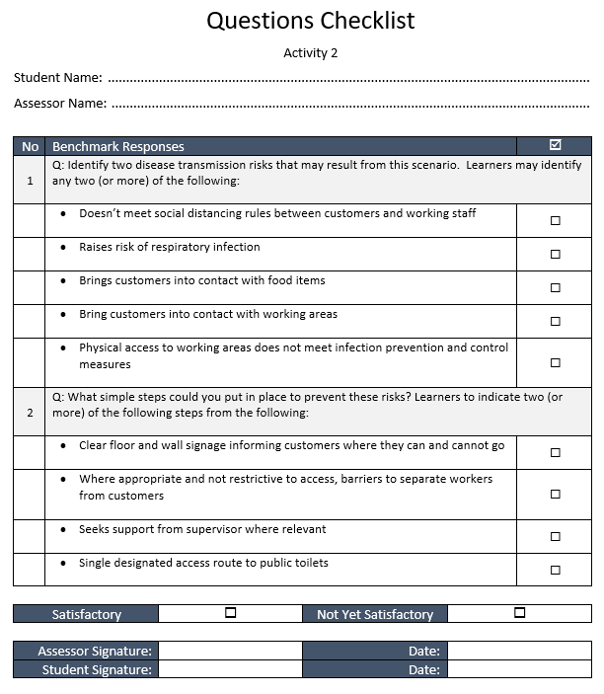
Written Work (Case Study with Written Questions)
2
A Case Study can place the learner in the heart of an industry relevant situation that would normally occur in the workplace. This enables the learner to apply that knowledge in context rather than structured question responses.
Example: I, the assessor, want to ensure that this learner understands how they would apply precautions to prevent disease transmission across their workplace area.
Case Study (part): In your role as Catering Assistant, you are checking your work area for potential infection related risks before your shift begins. You notice that there are public toilets a few meters away from the counter service area and that there is an accessible route to these facilities both in front of and behind the service area. One of these routes is one that you would regularly cross to access cutlery, plate items and also to transport food items.
Question: Identify two disease transmission risks that may result from this scenario.
Question: What simple steps could you put in place to prevent these risks?
Notice that there are interim assessor instructions within this evidence gathering tool pertaining to the question responses
Notes:
Time: 1½ mins
Deriving the case study – representative of an activity/situation within today’s workplace
Be INFORMED by industry
Measure how learner interprets the situation
Benchmark responses

Slide 30
On-the-job Practical Assessment Activity
3
This activity will enable the learner to PERFORM and actively apply skills and knowledge within an actual workplace setting.
Learner:
The learner is DOING.
Just DOING.
In this instance, they are not submitting what they are doing.
IDENTIFY the Observable Behaviours and construct activity instructions in a way that the learner can accurately and easily interpret the intended requirements of the task and sufficiently DO the required seeing, hearing, tasting, smelling and feeling components.
Assessor:
The assessor is DIRECTLY OBSERVING the learner demonstrate skills through performance of observable behaviours.
Remember, our assessment activities must ENABLE the learners to PERFORM or DO the observable behaviours for them to be deemed VALID assessments.
Notes:
Time: ½ min
As slide.

Slide 31
PC2.1 Use resources and equipment according to organisational infection prevention and control procedures
Observed Performance
Ascertain/measure knowledge
“List the resources and equipment you would use to complete cleaning tasks to customer expectations.”
“Describe in no more than 300 words how you would use equipment to complete cleaning tasks to customer expectations.”
“Select all resources and equipment from the checklist provided below that are included within the organisation’s infection prevention and control policy.” (List follows for learner to select).
“A customer has hired the catering company that you work for. The customer informs that they will be using a specific location to host an event that accommodates 20 attendees and is obligated to ensure that the area meets all infection prevention and control expectations before, during and after the event. Explain what measures you would undertake to ensure the customer’s expectations are met.”
Performance – Use the verbs to guide your ‘performance’ instructions
Notes:
Time: 1½ mins
Example of INVALID ASSESSMENTS.
The student will DO what you tell them to DO.
They may DO what you have instructed as outlined here.
But the assessment would be deemed INVALID.
Don’t get instructions that result in written or verbal response work confused with observable behaviours.
1. LOOK at the verbs. What is the learner DOING?
The Assessor is to WATCH/OBSERVE the learner’s PERFORMANCE.
Do the instructions ENABLE THE LEARNER to do this?

Slide 32
On-the-job Practical Assessment Activity
3
This activity will enable the learner to PERFORM and actively demonstrate their skills being applied within an actual workplace setting.
Doing – Verb Focus, Sufficiency e.g. Amount of ‘Doing’
What learners must know in order to perform a task
Performance Standards
Performance Criteria
PC1.3 Identify infection hazards associated with work activities and environment and assess the risk according to organisational procedures
PC 2.1 Use resources and equipment according to organisational infection prevention and control procedures and manufacturer specifications
Performance Evidence
Identify at least two different infection hazards, assess the risk they pose, and respond to each with scope of own role and responsibilities (PE2)
Demonstrate the use of required precautions and control measures, as required for own work activities (PE3)
Knowledge Evidence
Infection hazard nature and types (KE1)
Precautions and control measures (KE4)
Protocols required by own work activities (KE7)
Foundation Skills
Oral Communication (FS1)
Initiative and Enterprise (FS5)
Problem Solving (FS6)
Assessment Conditions
Access to suitable facilities, equipment and resources e.g. procedures, PPE hygiene facilities, waste disposal equipment, areas for cleaning (All ACs)
All manner of physical and environmental items, areas and access enabling learners to perform
LLN, Employability = Capability
Notes:
Time: 2 mins
Inform:
Performance Criteria
Foundation Skills
Knowledge Evidence
Performance Evidence
Assessment Conditions
Then ….
Remind participants of what these sections represent …. E.g.
Performance Standards
LLN, Employability = CAPABILITY
What learners must know in order to perform a task
All manner of physical and environmental items, areas and access enabling learners to perform
Assessment Conditions:
Note: The learner cannot PERFORM the task without these things in place.
Student Instructions: What is the Learner to DO?
Assessor Instructions: What is the Assessor to provide/ensure is in place to enable the learner to DO/PERFORM?
And DOING.
Verb focus.
Doing specifics.
Sufficiency e.g. Amount of ‘doing’

Slide 33

On-the-job Practical Assessment Activity
3
Task: The learner is working as an assistant for a hospitality catering company. This task involves applying infection control practices and procedures before, during and after an arranged event that provides food service to 20 attendees.
Primary Audience
Task Component: Identify Potential Risks and Hazards
Prior to the commencement of your workplace activities, check your working areas to see whether there are any potential infection-related hazards. Look for hazard types that may affect you, your work colleagues or customers throughout the course of the workplace event.
Assess the risks that these hazards may present and the potential harm that may come to yourself, others working around you or customers you are to serve throughout the event should they occur. Consider how likely these risks are to happen.
Seek out your supervisor, discuss the nature of these risks with him/her and suggest actions to prevent them from actually occurring.
With supervisor approval, apply preventative measures to minimise the level of risk.
When
Where
What
Who
How
Learner Instructions
Principles of Validity and Reliability
ENABLING Rules of Validity and Sufficiency
Notes:
Time: 2 mins

Slide 34
On-the-job Practical Assessment Activity
3
Task: The learner is working as an assistant for a hospitality catering company. This task involves applying infection control practices and procedures before, during and after an arranged event that provides food service to 20 attendees.
Secondary Audience
Task Component: Identify Potential Risks and Hazards
Ensure that two or more hazard items are apparent within or around the working area so that learners may identify risks and relevant infection prevention and control measures during this task.
These hazards may include:
PPE items
Working area signage
Access for staff and/or customers
Access to infection prevention materials/tools
Ensure learners are informed prior to the commencement of the task who their supervisor is for reporting issues to.
Examples:
What must I ensure is in place to enable my learners to perform the task?
What things might I need to prepare for them?
What things must I let them know?
Are there any specifics that I must look out for throughout the duration of the task (outside of the assessment evidence I am gathering)?
Assessor Instructions
Notes:
Time: 1½ mins

Slide 35
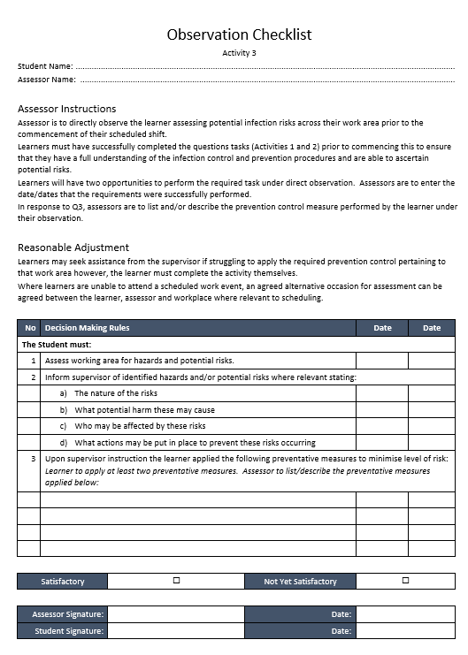
On-the-job Practical Assessment Activity
Evidence Gathering
‘Talk to’ the Assessor
3
Enable the Assessor to make a valid, reliable, fair and flexible judgment
Equip the Assessor with instruments that enable them to make consistent judgments
Primary Audience
Notice that there are interim assessor instructions within this evidence gathering tool pertaining to the question responses
Principles of Validity and Reliability
ENABLING Rules of Validity and Sufficiency
Assessor Instructions
Notes:
Time: 1½ mins

Slide 36

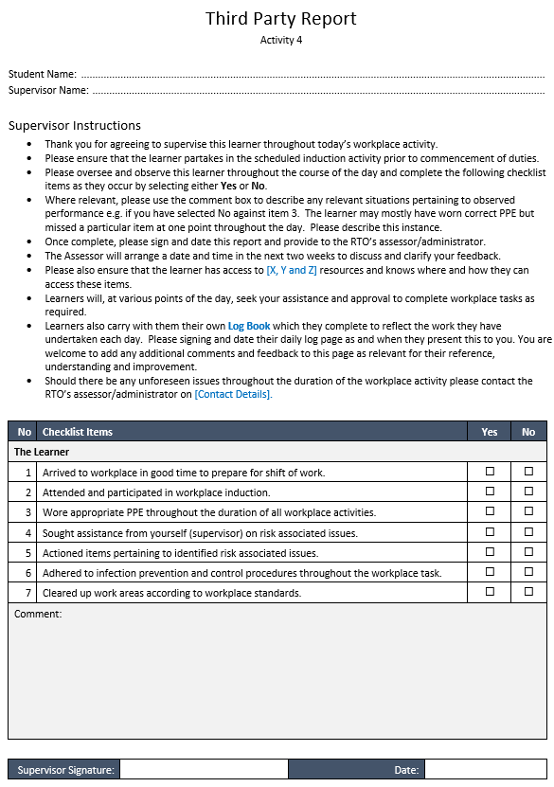
On-the-job Practical Assessment Activity – Third Party Report
4
Similar Task (New Context): The learner is working as an assistant for a hospitality catering company. This task involves applying infection control practices and procedures before, during and after an arranged event that provides food service to 20 attendees.
Supervisory/Managerial work role
Ensures that operational work tasks are undertaken
Is NOT a qualified assessor
Is NOT required to make assessment judgments
Working role is that of an Assessor
Enables learners to meet assessment requirements
IS a qualified assessor
IS required to make assessment judgments against standard criteria
Third Party Instructions
Observes the Learner
Makes Assessment Judgments
Assessor Instructions
Notes:
Time: 1 mins

Slide 37
On-the-job Practical Assessment Activity – Third Party Report
What do you want them to DO? For example:
Preparatory set up work e.g. hazard items, inform learners who the supervisor is (if not the third party), etc.
Take an attendance register
Check and sign a learner progress log book
2. What do you want them to REPORT that they have observed?
We are not asking them to make a judgment on whether or not the learner did things to assessment standards.
You may want to know if the learner, for example:
Completed the scheduled hours so arrived on time and left at the appropriate time.
Wore appropriate PPE
Sought assistance
Discussed risk items
Did anything about these items
Cleaned and cleared working area to required workplace standards
Third Party Instructions
4
Notes:
Time: 1 mins
Consider the clarity of the instructions for the Third Party.
They are not the learner.
They are also not an assessor.
Think about their interpretation of requirements.
If unsure, add in a ‘check’ activity between the assessor and third party to clarify requirements before activity commencement.

Slide 38

Off-the-Job (Direct)
5
Task: As Activity 3 - direct observation by Assessor of observable behaviours performed by the learner.
Difference - performance within a SIMULATED environment location rather than an actual workplace.
Mandatory conditions maintain training package integrity
Ensure required policies and procedures, facilities, equipment, materials, clothing, etc are used during the activities
Assessment Conditions MUST be met irrespective of where activity is conducted. There is no ‘adjustment’ to account for the activity NOT being conducted within the workplace
The learner must ‘realise’ the location as the workplace and ‘associate’ it with that which represents a real workplace environment
Utilise people or clients who have real or simulated goals
Client participants to be provided with enough information to accurately play their part
Assessment Conditions
Skills in this unit must be demonstrated in a workplace or simulated environment where the conditions are typical of those in a working environment in this industry. This includes access to:
Suitable facilities, equipment and resources, including:
Organisational infection prevention and control procedures and guidelines
PPE suited to work role and job requirements
Hygiene facilities and equipment relevant to workplace
Waste disposal equipment suited to waste generated during work activities
Areas for cleaning
Benefits
Controlled Environment
Structured Setting
Practice Conditions
Safe Skill Development
Stop and Start
Confidence Building
REAListic Scenario
Valid
and
Reliable
Notes:
Time: 1½ mins This unit specifies that skills must be demonstrated in either a work place or a simulated environment.
The assessment conditions stipulate any mandatory conditions for assessment and maintain the integrity of the training package.
No matter where practical assessment is conducted, assessment must utilise other people who are clients who have real or simulated goals.
This includes information about the policies and procedures needed, the facilities, equipment, materials, clothing etc to be used and the activities that must be undertaken.
It is important to be aware that all of these assessment conditions must be met whether you are conducting the assessment in a workplace or a simulated environment.
That is, even if you are conducting assessment within an infection controlled workplace such as a catering establishment, a fitness centre, a medical centre, etc, you must ensure that that workplace meets all of these criteria. This ensures assessment is relevant for the industry area reflected within the unit.
No matter the location where assessment is conducted, if the assessment uses people to act as clients in a role play or simulated activity you must ensure that those participants are provided with enough information to help them accurately play their part. The scenario must be suitably realistic to ensure that assessment is valid and reliable.

Slide 39
The Assessment System – What is the evidence?
Policies and Procedures
Policies
Unit of Competency
TGA
Assessment Tools and Instruments
Representative of:
Recording and Reporting Instruments
Within the tools
Monitoring and Evaluating Tools
Assessment Tool Matrix/Checklist
Unit Specs
Assessment Requirements
Industry Information e.g. legislative or directly informed
Training Package
Industry
Mapping (alignment)
Student Profiles
Class/Cohort/ Group Profiles
AVETMISS reporting software
Validation Plan
Validation Outcomes documentation
Continuous Improvement Log/Register
Principles of Assessment
Rules of Evidence
Activity Instructions
Reviewing and Trialling
Planning and Development
Storage – accessibility – use and approval
Version control
Industry consultation
Customisation and contextualisation
Formatting – Template, Style, Brand etc
Evidence Gathering
Benchmark Tools
Guides
Validator Verification
Notes:
Time: 1 mins
Building up to why this webinar is ABOUT the unit TAEASS502 and where, within the Assessment System of tools and processes, this unit FITS.
The Assessment System
An Evidential process.
Whatever the practice is, this must be represented by documented evidence.
The system does not belong to any single assessor or author of assessment.
What we are designing and developing is a component of that system and its process and documented evidence and this is where this TAE unit of competency falls.
Policies
Planning and development
Industry consultation
Customisation and contextualisation
Formatting – Template, Style, Brand etc
Storage – accessibility – use and approval
Version control

Slide 40

Develop the Assessment Tool
Assessment Policies and Procedures
Storage
Where are assessment tools, outcomes, records and
student work kept?
Who has access to these and why?
Retrieval
Consider purposes of retrieval
Approve
Systematic Evaluation
The RTO’s evaluative practices e.g. Internal Review, Validation
Who, What, When, Where and How
Version Control
Separate Current from Archive
Review and redevelop
How long for?
Log/Register to show most recent version in use
Use dates!!
Notes:
Time: 1 mins

Slide 41


Review and Trial the Assessment Tool
Storage, Retrieval and Version Control
Storage
WHERE are you storing/archiving the assessment materials, tools and resources?
What is the level of ACCESSIBILITY?
Paper based storage location
Digital Organisation Drive
Cloud based access
Retrieval
WHY would a person need to access current and/or archived assessment tools?
WHO is given access rights?
HOW can an individual access assessment materials, tools and resources AND evidence of assessment judgments (past and present)?
Restricted (encrypted) access
Ownership
Permissions (use and amendment)
Are these processes documented within the Assessment System policy and procedure?
Notes:
Time: 1 mins
Three key steps to Trialling the Assessment Tools
Validation of Assessment Tools and Instruments (pre-assessment). There is no resulting student work at this point.
Trial Readers. Select willing participants e.g. learners, industry personnel, other trainers and assessors to acquire their interpretative feedback. They don’t have to DO the assessment.
First Assessment Issue. Work with the first cohort of learners applying a more vigilant set of administration and feedback process.
After this, the RTO’s procedures for systematic evaluation and contribution to continuous improvement year on year should kick in.
Schedule the assessment’s FIRST official post-assessment validation event (with student work) once that first cohort have received their assessment judgments.

Slide 42
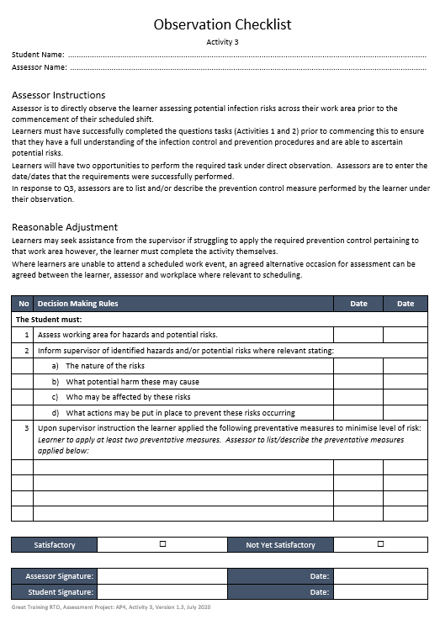
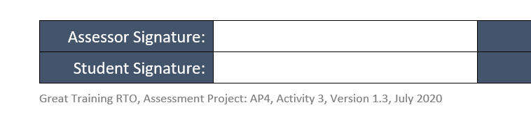
Review and Trial the Assessment Tool
Storage, Retrieval and Version Control
Version Control – what is that exactly?
The use of numbered/lettered references, usually placed within the footer of a document, so that the reference is repeated across the whole tool. This enable the tool to be identified as the latest version of itself.
Embedded within the tool in accordance with the RTO’s policy and procedure for formatting and template use.
Whatever the Version Control system that is in place, this must be a clear and transparent procedure to all involved in the RTO’s document design and development practice.
Example:
A common method of Version Control use is where the author’s first final draft begins at Version 1.0.
When a minor amendment is made to the tool it would be separately saves as Version 1.1. Version 1.0 would then be ‘archived’ e.g. put inside of a file called ‘Archive’.
Should a major change be made it may be the RTO’s policy to go straight to the next number, e.g. Version 2.0.
Notes:
Time: 1 mins
Three key steps to Trialling the Assessment Tools
Validation of Assessment Tools and Instruments (pre-assessment). There is no resulting student work at this point.
Trial Readers. Select willing participants e.g. learners, industry personnel, other trainers and assessors to acquire their interpretative feedback. They don’t have to DO the assessment.
First Assessment Issue. Work with the first cohort of learners applying a more vigilant set of administration and feedback process.
After this, the RTO’s procedures for systematic evaluation and contribution to continuous improvement year on year should kick in.
Schedule the assessment’s FIRST official post-assessment validation event (with student work) once that first cohort have received their assessment judgments.

Slide 43
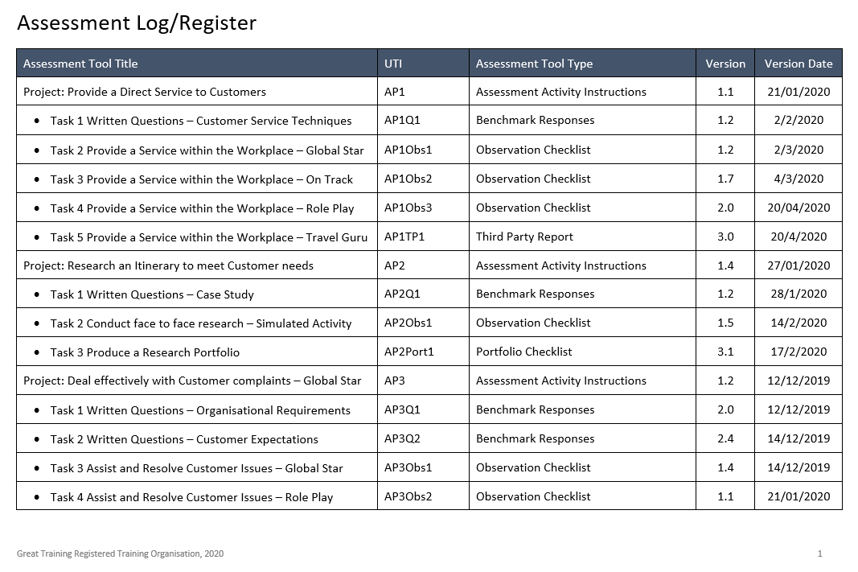
Review and Trial the Assessment Tool
Storage, Retrieval and Version Control
Version Control
WHO is authoring? WHO is making changes? WHO is applying continuous improvement amendments?
Note: Don’t assume that the ‘paper based’ version in your hand or a digital document forwarded to you is the latest version.
HOW do you know what the latest version is?
The RTO must have a robust system that:
Stores ARCHIVE versions for reference purposes
Lists CURRENT versions for accessibility, retrieval, use and amendment by assigned persons e.g. Assessment tool log/register.
Continued transparency of document usage that is version controlled.
Notes:
Time: 1 ½ mins
Three key steps to Trialling the Assessment Tools
Validation of Assessment Tools and Instruments (pre-assessment). There is no resulting student work at this point.
Trial Readers. Select willing participants e.g. learners, industry personnel, other trainers and assessors to acquire their interpretative feedback. They don’t have to DO the assessment.
First Assessment Issue. Work with the first cohort of learners applying a more vigilant set of administration and feedback process.
After this, the RTO’s procedures for systematic evaluation and contribution to continuous improvement year on year should kick in.
Schedule the assessment’s FIRST official post-assessment validation event (with student work) once that first cohort have received their assessment judgments.

Slide 44
Review and Trial the Assessment Tool
Unique Tool Identifiers (UTIs)
Assessment Project
(Student Instructions)
Assists the Assessment Tool identification process including version control
Easier referencing within the Assessment Plan, TAS and mapping documents
Enables retrieval of tools for purpose of validation events
Each Identifier is unique to the tool – not repeated
Without these, users are dependent upon the title of the project and the title of the assessment method e.g. Observation Checklist, of which there may be more than one.
UTI = AP1
Evidence Gathering Tools
Assessment Activity 1
Written Questions
Assessment Activity 2
Written Case Study
Assessment Activity 3
Workplace
On-the-Job
Assessment Activity 4
Workplace
On-the-Job
Assessment Activity 5
Simulated
Off-the-Job
Questions Checklist with acceptable benchmark responses to written questions
Written Work Checklist with Decision Making Rules
Direct Observation Checklist with Decision Making Rules
Third Party Report with supplementary criteria
Direct Observation Checklist with Decision Making Rules
AP1Q1
AP1W1
AP1Obs1
AP1TPR1
AP1Obs2
Notes:
Time: 1 ½ mins
If I saw referenced within a validation document the following tool identifiers:
AP2Q3 - Project 2, Questions Task 3
AP3Obs2 – Project 3, Observation Checklist 2
AP4TPR1 – Project 4, Third Party Report 1
I would know just by the identifiers what tools I am accessing, retrieving, referencing, and using for a given purpose such as mapping or validation.

Slide 45
Review and Trial the Assessment Tool
Checking Assessment Tools against Evaluation Criteria – Principles of Assessment
Principle | Criteria for Consideration
Validity | Are all tools included within the mapping document to show clearly where evidence is meeting the requirements of the unit? Do the tools provide opportunities to demonstrate knowledge and skill across a range of differing contexts e.g. more than one given industry relevant situation? Do the tools cover the broad range of skills and knowledge essential to competent performance? Do the assessment activities provide opportunities for learners to demonstrate both knowledge and skill within their practical application? Do the tools enable the assessor to make valid assessment judgments against the requirements of the unit?
Reliability | Are Student Instructions clear enough for learners to consistently interpret the assessment requirements? Do Student Instructions enable learners to DO and SUBMIT evidence that consistently meets expectations e.g. unit requirements, industry relevance, context, etc. Do Assessor Instructions enable the assessor, irrespective of which assessor it is, to administer assessment instruments and use them effectively to make comparable, valid and reliable assessment judgments?
Flexibility | Do the assessment activities and the methods applied for gathering evidence enable the allowance for flexibility without undermining the integrity and validity of the tool? Does that flexibility reflect learner needs where relevant? Are a range of assessment methods available that are appropriate to the: Unit requirements, Context and associated assessment requirements Individual learner
Fairness | Do the set assessment tasks and techniques used for gathering evidence consider the needs of individual learners throughout the assessment process? Do they give any learners an unfair advantage or pose an unfair disadvantage. Have possible reasonable adjustment arrangements been put in place should the need arise to meet a given individual learner’s need? Have learners been informed about the possibility of reasonable adjustment that they may have a right to make use of where relevant?
This practice:
informs the design and development of your assessment materials
enables you to make compliant validation decisions
quality assures your own validation practices
Notes:
Time: 1½ mins
If you are not very experienced with reviewing and validating tools the requirements of the Principles of Assessment and Rules of Evidence can be a little daunting.
It is best to SPEND SOME TIME with the Principles and Rules and break down the requirements for yourself.
Devise some aligned questions within a checklist of your own so that, as and when you partake in this type of process you can answer your own questions as you work through.
Irrespective of the TEMPLATE you need to fill in, you will know that, if you have answered your own questions, you will have an outcome to provide in whatever BOX has been provided within whatever TEMPLATE that has been provided to you.
As Slide.

Slide 46
Review and Trial the Assessment Tool
Checking Assessment Tools against Evaluation Criteria – Rules of Evidence
Rule | Criteria for Consideration
Validity | Is the evidence submitted by the learner what it claims to be evidence of e.g. has the learner returned evidence that aligns to the assessment activity instructions – what they have been asked to DO and what they have been asked to SUBMIT?
Sufficiency | Has the assessor observed and/or received ENOUGH evidence in order to return a satisfactory assessment judgment for the task(s)?
Authenticity | Is the evidence provided the learner’s own work? What evidence do you have to prove that it is the learner’s own work? This criteria must not be called based on what the assessor believes. The evidence must be irrefutable.
Currency | Does the evidence represent task knowledge and skills that is currently relevant to the industry area aligned to the context described within the assessment? Has the assessment performance been observed recently? Has the assessment work been submitted recently?
Other | Criteria for Consideration
Industry Relevance | Is the task requiring the learner to apply skills and knowledge that are relevant to industry today?
Contextualisation | Does the tool present an assessment activity that is accurately contextualised to represent the situation as it would occur in the workplace (for that industry field)?
Dimensions of Competency | Does the assessment provide opportunities for students to apply Task skills, Task management skills, Contingency management skills and Job role/Environment skills
AQF Level | Knowledge (at this level) Skills (at this level) Application of Knowledge and Skills (at this level)
Evaluation Practices result in Continuous Improvement Outcomes
Notes:
Time: 1½ mins
Currently, there is a very HIGH LEVEL OF NON COMPLIANCE across the way validation is conducted and the outcomes derived.
What this tells us is that the majority of assessors are MISINTERPRETING the requirements of the POA and the ROE therefore, DO YOURSELVES A FAVOUR and SPEND SOME TIME with them. Come to terms with them.
This will ultimately:
inform your design and development of your assessment materials.
Enable you to make compliant validation decisions
Quality assure your own validation practices

Slide 47
Review and Trial the Assessment Tools
Trialling the Assessment Tools
Validation (Pre-Assessment)
Trial Readers (SMEs)
First Issue (Learner Response)
Validation of Tools only (not student work)
Validate against the POA and ROE requirements
Identify gaps/rectifications
Amend where applicable
Purpose: Your Self-Assurance that you have covered everything (as YOU interpret it) you can to ensure valid content and applicability.
Collect and analyse feedback
Apply amendments where applicable
Final formatting
Purpose: Your Self-Assurance that you have applied the requirements
(as RELEVANT OTHERS interpret it) from feedback provided and, after analysis, applied amendments to the tool(s) based on that feedback.
Prepare to ‘adjust as you go’
Example: Alter ‘usual’ administration methods e.g. may simply issue paper based assessment.
On first occasion, read through it all with them and ask for them to verbally iterate their interpretation of the requirements.
Make learner feedback, that would usually be optional, mandatory.
Here you are using a real ‘live’ situation without disadvantaging your learners.
Notes:
Time: 2 mins
Three key steps to Trialling the Assessment Tools
Validation of Assessment Tools and Instruments (pre-assessment). There is no resulting student work at this point.
Trial Readers. Select willing participants e.g. learners, industry personnel, other trainers and assessors to acquire their interpretative feedback. They don’t have to DO the assessment.
First Assessment Issue. Work with the first cohort of learners applying a more vigilant set of administration and feedback process.
After this, the RTO’s procedures for systematic evaluation and contribution to continuous improvement year on year should kick in.
Schedule the assessment’s FIRST official post-assessment validation event (with student work) once that first cohort have received their assessment judgments.

Slide 48

Development Tip
Build Mapping References as you develop the tools and instruments
Check Mapping tool for gaps and continue to build where relevant
1
4
5
Unit Info
Map Tool
Build Decision Making Rules as you develop the activities
2
Activity Instruction Document(s)
3
Draft Activity Instruction document(s) AND generate ‘dummy’ EGTs to represent selected assessment methods
EGT
EGT
EGT
EGT
Notes:
Time: 1mins

Slide 49
Development Tip
Immerse yourself within the unit(s) by spending quality time engaging with its requirements.
Envision yourself APPLYING the SKILLS and the KNOWLEDGE.
Take yourself away from DISTRACTIONS.
When you are authoring your initial draft(s), keep your mind clear and do this with nobody else around.
REALLY understand the REQUIREMENTS and EXPECTATIONS of the unit(s) and the variety of contexts that exist within the industry field it/they align to.
This is one way to successfully unpack the components of the unit in accordance with your own subject matter expertise and CREATE an engaging, enjoyable, industry relevant learning experience for your learners that the assessors can enjoy too.
If co-authoring or working with an ‘other’, still apply the above and highlight those areas where you are dependent upon an ‘other’ to inform the development of the assessment.
Notes:
Time: ½mins

Slide 50
WHAT WE HAVE COVERED…
Design recap - what did we cover yesterday?
Storage, Retrieval and Version Control
Assessment Review and Trial Practices
Developing assessment tools and instruments
User Instructions
Application of Evidence Gathering Techniques
Notes:
Time: ½ mins

Slide 51

ANY QUESTIONS?

Slide 52

WHAT HAPPENS NOW?
WITHIN 48 HOURS, YOU WILL RECEIVE AN EMAIL INCLUDING:
A Statement of Attendance
A link to event feedback survey
Access to the WMV recording of the webinar for three months
PDF copy of the PowerPoint
PDF transcript of Chat Q&A
BONUS RESOURCES
12 x resources! Example checklists and templates to assist with your Assessment practices

Slide 53
UPCOMING EVENTS
Today: Webinar 1pm-2pm (MRWED)
Unpacking Training Packages to Meet Client Needs
Tomorrow’s TAE PD Week webinars…
3 December @ 11am: Webinar
Enhancing How You Plan, Organise and Deliver Group-based Training
3 December @ 1pm: Webinar
Breaking Down Assessing Competence
*All webinar times are shown in AEST (QLD time)

Slide 54
CONTACT US
Velg Training
1/52 Jeffcott Street
Wavell Heights QLD 4012
P 07 3866 0888
E webinar@velgtraining.com
W velgtraining.com

Slide 55
THANK YOU FOR YOUR COMPANY
We really hope you enjoyed engaging with Melanie Alexandra for your webinar today.
If you have any queries or feedback relating to today’s topic, or any general questions regarding your role within the VET sector, do not hesitate to contact the team at Velg Training.
Phone: 07 3866 0888
Email: melanie@velgtraining.com.au
Website: www.velgtraining.com
LinkedIn: Melanie Alexandra

