Slide 1
YOUR WEBINAR WILL BEGIN SHORTLY
audio tests may occur during this period

Slide 2


Slide 3
The DESIGN and DEVELOPMENT of Assessment Tools – Part 1
Melanie Alexandra

Slide 4

ABOUT: Melanie Alexandra
Melanie Alexandra has held a variety of roles across both the academic and vocational education sectors including that of Trainer and Assessor, Curriculum Manager, RTO Manager, Head of Faculty, Head of Quality Assurance, and Senior Lead Auditor.
Over the past decade Melanie has conducted hundreds of regulatory audits and registrations against the current legislated VET Quality Framework and now provides quality VET audit and compliance consulting services in support of Registered Training Organisations and providers of VET in Schools.
Phone: 07 3866 0888
Email: melanie@velgtraining.com.au
Website: www.velgtraining.com
LinkedIn: Melanie Alexandra

Slide 5

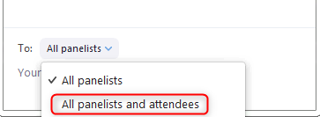
NAVIGATING ZOOM

Slide 6

RAISE YOUR HAND IF YOU CAN HEAR ME
(audio test)

Slide 7
POLL…
WHO’S ONLINE TODAY?

Slide 8
TAEASS502 Design and Develop Assessment Tools – Two Parts
Application: “Design and develop assessment tools used to guide the collection of quality evidence, including their application in formative, summative and recognition of prior learning (RPL) assessment.”
Part One (Now)
Determine the focus of the assessment tool
Design the assessment tool
Part Two (Tomorrow)
Develop the assessment tool
Review and trial the assessment tool
Notes:
Time: ½ min
How we are addressing the unit components over two webinars.

Slide 9
WEBINAR OVERVIEW
The purpose of Assessment Tools – why do we need them?
Applying the right assessment methodology
Administering the component instruments
Knowing who your target audience and end users are
Designing tools and instruments – how do we begin?
Understanding criteria and contextualisation
Meeting Principle of Assessment requirements
Notes:
Time: ½ min
We only have 60 minutes to cover this lot but I shall do my best.

Slide 10

The Purpose of Assessment Tools
Assessment means the process of collecting evidence and making judgements on whether competency has been achieved, to confirm that an individual can perform to the standard required in the workplace, as specified in a training package or VET accredited course.
Assessment system is a coordinated set of documented policies and procedures (including assessment materials and tools) that ensure assessments are consistent and are based on the Principles of Assessment contained in Table 1.8-1 and the Rules of Evidence contained in Table 1.8-2.
Source: Glossary, Standards for RTOs 2015
Notes:
Time: 1 min
WHAT DO THE STANDARDS SAY?
Quoting the Standards to confirm the PURPOSE behind designing and developing Assessment Tools

Slide 11


The Purpose of Assessment Tools
WHAT ….
is being assessed?
evidence is being requested?
standards/rules is evidence being assessed against?
judgements are being made?
HOW ….
is it being assessed?
is that evidence being demonstrated?
does the requested evidence align to those standards?
are judgements being made?
Notes:
Time: 1 min
It is all about MEASURING THE PRACTICE and MEASURING THE OUTCOMES.
Presenting the DIFFERENCE between what is verbally presented by the assessor to the student and what is documented.
The intention here to convey a message of MEASURABILITY e.g. CANNOT measure verbal instructions and assessment which is not benchmarked.

Slide 12
The Assessment System – What is the evidence?
Policies and Procedures
Policies
Unit of Competency
TGA
Assessment Tools and Instruments
Representative of:
Recording and Reporting Instruments
Within the tools
Monitoring and Evaluating Tools
Assessment Tool Matrix/Checklist
Formatting – Template, Style, Brand etc
Storage – accessibility – use and approval
Version control
Unit Specs
Assessment Requirements
Industry Information e.g. legislative or directly informed
Training Package
Industry
Mapping (alignment)
Student Profiles
Class/Cohort/ Group Profiles
AVETMISS reporting software
Reviewing and Trailing
Validation Outcomes documentation
Continuous Improvement Log/Register
Principles of Assessment
Rules of Evidence
Activity Instructions
Validation Plan
Planning and development
Industry consultation
Customisation and contextualisation
Validator Verification
Evidence Gathering
Benchmark Tools
Guides
Notes:
Time: 1 min
Building up to why this webinar is ABOUT the unit TAEASS502 and where, within the Assessment System of tools and processes, this unit FITS.
The Assessment System
An Evidential process.
Whatever the practice is, this must be represented by documented evidence.
The system does not belong to any single assessor or author of assessment.
What we are designing and developing is a component of that system and its process and documented evidence and this is where this TAE unit of competency falls.

Slide 13




Who has an interest in the developed Assessment Tools and why?
Assessor
Using the tool
Clear and representative instructions
Enabling the job e.g. gathering of evidence, making judgements, providing feedback
RTO
Core Business
Legislation/Compliance
Costs
Timeframes
Resources
The How – Meeting the purpose
Quality Assurance
Student
Using the tool
Does it tell them what they want to know ….
  What do I do?
  What do I submit?
Clear and representative instructions
Enabling the assessment of competent performance
Employer
Training for Industry
Enabling the required skills
Certificate Evidence
Notes:
Time: 1½ min
Employers are either:
Enrolling their employees as students on a course to upskill and enable them to perform required tasks, or
Recruiting employees who hold the training package skills
Training package has been written to represent that industry field so employer wants to feel secure and confident that the employee or potential employee is currently qualified to perform the role
The certification is ‘evidence’ of achievement. It endorses the skills the employer is looking for.
RTOs:
Training and Assessment is their Core Business – they have an obligation to their learners and ultimately to those paying them for their services
They have a legislated obligation to meet the requirements of the Standards
They have cost considerations e.g. information gathering, required resources, development time, trialling, validating etc.
Deadlines – add a course to scope, update a course to meet training package requirements, industry requirements or other outcome that has dictated the change
Resources: Getting the right personnel in place, the assessor, the validation team, the industry representatives, the author, the mentor, the approver
Meet the set requirements and fitting the purpose
Quality assured processes and materials, representative of the RTO and its service - reputation
Assessors:
Student:
Review this information against Michelle’s presentation.

Slide 14

WAIT!
What if I am new to this process and have been handed assessment materials and tools (either by a previous VET trainer and assessor or third-party) already developed?
What if the assessment materials have been purchased as an off-the-shelf product, from a resources development provider, already developed?
Notes:
Time: ½ min
BRIEF SLIDE – Less than 20 seconds
BUT WAIT!!!!
TALK TO THIS ….

Slide 15

The Author
(Designer and Developer)
Who might our author be?
Assessor employed by the RTO
Part of a development team employed or contracted by the RTO
Full time resource developer
Independent trainer and assessor
Consultant
Other
The End User
(of the assessment tools)
Target Audience
Notes:
Time: 1 min
This presentation is primarily focused at those who are authoring in house for their RTO or are the assessor themselves but all information provided pertains to those who are simply reviewing tools that have already been purchased in by the RTO.
The RTO is under obligation to maintain compliance and quality across their assessment practices and materials and therefore those who REVIEW assessment tools need to view these with the same understanding of the design and development principles as intended from this unit of competency.
Whilst the Client is important, we are writing to satisfy the assessment needs of the Students and the Assessors.

Slide 16

The Target Audience = The Assessor(s)
What do we know about them?
Who are they?
What information do they need to be provided with about the tools?
  Who the assessment tools have been written for
  Intended for a train and assess situation or an assessment only pathway
Clear Instructions
  For direct assessment e.g. talk TO the Assessor (tell them what to do)
  For indirect assessment or the provision of supplementary evidence e.g. talk TO the Assessor and/or an ‘other’ party
The boundaries of reasonable adjustment
  Alternative tasks with representative benchmarks (can this occur)
Notes:
Time: 1 min
More on our target audience and end users as we work through this presentation.

Slide 17

The Target Group (Students)
What do we know about them?
Factual Information (Group Demographics)
AQF Level
Previous experience/pre-determined entry requirements/pre-requisite achievement
Current employment
Required Language Level (AQF, ESL, LLN)
Location/Accessibility (Workplace, Simulated Environment, Distance)
Assessment type (Blended assessment, online, face to face, RPL, etc)
Notes:
Time: ½ min
As Slide.

Slide 18






The Target Group (Students)
What do we know about them?
Warm and Fuzzy Information (Range of Ability/Point of difference)
Level of understanding
  reader interpretation
  language
  culture
Digital literacy
  Age
  Technology Experience
  Background/Culture
Potential reasonable adjustment
  acceptable levels of differentiation across tasks
  essential support/supervision
3
Qualification Level
2
1
Notes:
Time: 2 min (This slide PLUS the next slide)
Present a COHORT at Level 2. - This is a lovely picture hey? All at the same level of understanding when we enrol them?
Next Slide.

Slide 19
The Target Group (Students)
What do we know about them?
Warm and Fuzzy Information (Range of Ability/Point of difference)
Level of understanding
  reader interpretation
  language
  culture
Digital literacy
  Age
  Technology Experience
  Background/Culture
Potential reasonable adjustment
  acceptable levels of differentiation across tasks
  essential support/supervision
3
Qualification Level
2
1
Notes:
When considering all of these things, each of your learners will be a little bit more like this e.g. somewhere within a RANGE that falls slightly below to slightly above that qualification level.
Written Communication Level.
Using language and terminology that will cater for the RANGE of students enrolling on to the course.
Qualification level of the assessment – not a ‘given’ that all learners enrolled are at that level
Language level of the learners
Accessibility of the tools e.g. online, assessor issued and supported
How likely are they to receive the information presented within your assessment tools in a manner which is intended?
Are there reasonable adjustment considerations from the out set?
KNOW the target learner group. This impacts upon:
The type of activities included
The way the activity is instructed and written
The restrictions
The alternative opportunities available
YOUR tools will be seen and interpreted by students in different ways. How do YOU know that they have received YOUR messages LOUD AND CLEAR! ???

Slide 20

Determine the focus of the assessment tool
Target Candidate Group
Contextualisation to meet learner needs
Can your assessment tools and practices accommodate and enable this learner?
Consider range of ability and potential points of differentiation, alternative methods of assessment
3
Qualification Level
2
Can your assessment tools and practices accommodate and enable this learner?
Consider range of ability and potential points of differentiation, additional tasks (in context), further consolidation exercises for learner, etc.
1
Principles of Fairness and Flexibility
Notes:
Time: 1 min
Adapting your Tools
This is where ASSESSOR INSTRUCTIONS must be so very clear.
Write to the qualification level with consideration towards to potential range of ability and points of differentiation across a given cohort.
Ensure that your instruments do not put learners at a disadvantage and also encourage further achievement.
Once you have completed all things design and development – ask yourself ‘ Is the task appropriate to that AQF level?

Slide 21


Designing Assessment Tools for the End User
Considering the Assessment ‘Situation’
Content
Training package (unit)
Industry (relevant)
Compliance (standards)
Legislation (VTA)
Customer (brief)
End user context (identify)
Style
Template (RTO/ design)
Style guide (policy)
Branding (client)
Restrictions (brief)
Existing issues (re-design)
Version control
Other
Scheduling (task order)
Timeframes (completion)
Costs (develop/purchase)
Inherent issues (fix)
D&D Planning (structure)
Where do I begin?
Principles of Validity and Reliability
Notes:
Time: 1½ min
Okay, so I get all of that.
WHERE DO I GET THE CONTENT FROM?
WHAT STYLE AND FORMAT AM I WRITING THIS IN?
WHAT OTHER CONSIDERATIONS DO I NEED TO TAKE INTO ACCOUNT?

Slide 22
QUESTION…
Please type your response in the chat window
What is your biggest concern when it comes to designing assessment tools?
Notes:
Time: 2 min
I am assuming audience will say ….
Instructions
Evidence gathering
Mapping
Auditor not agreeing with instructions
Not meeting unit requirements
Not interpreting POA/ROE correctly
Most of the above will be covered in this and tomorrow’s session.

Slide 23

Backward Design Model
What does a competent person look like?
“Begin with the end in mind”
Notes:
Time: ½ min

Slide 24
Backward Design Model
What does a competent person look like?
Backward Design Model | Identify desired results | Determine acceptable evidence that meet desired results | Plan assessment experiences and instruction
Your Design Process | Begin with the end in mind What does that competent person look like? | Enable learner performance to represent that of a competent person | Develop activities that beget competent learner performance
The Evidence | The Competent Person | Competent Assessment Judgement | Activity Instruction and representative Evidence Gathering Tools and Practices
Notes:
Time: 1 min
Move through the process one column at a time to fall upon were we are at …. Activity instruction and representative evidence gathering tools and practices

Slide 25
Determine the focus of the assessment tool
Purpose of the Assessment Tool
Sample Assessment Tool Types
What is it? | What purpose does it serve?
Activity instruction document | Provides assessment task instructions for students (primary audience)
Evidence gathering tool | Provides decision making rules for the assessor (primary audience) to use whilst gathering evidence and to inform an assessment judgement
Benchmark document | Provides a range of acceptable responses enabling fair, reliable and consistent assessment by the assessor (primary audience)
Mapping tool | Provides documented evidence of alignment between the tools and the unit requirements for the assessor (primary audience) to manage gaps in assessment
Assessor guide | Provides additional instructions where relevant for the assessor (primary audience)
Notes:
Time: 2 min
Let’s take a look at some typical Assessment Tool Types and what their ultimate purpose is.
You would actually ask yourself what tool do I need to meet this purpose?

Slide 26
Determine the focus of the assessment tool
Purpose and Context of the Assessment Tool
Sample Tool 1: Activity Instruction Document Task/Activity instructions that enable the learner to meet both training package and industry requirements. | Sample Tool 2: Observation Checklist Provides decision making rules for the assessor to use whilst gathering evidence (observing learner performance) and to inform an assessment judgement.
Think of a relevant activity and draft out that activity in rough. | The decision making rules must represent the observable behaviours expected of the learner in line with what the activity instructions will tell the learner to DO.
The activity itself must enable the learner to meet the requirements of the training package. This means components of the unit that you have selected which meet that relevant activity (e.g. context). Identify specifically what parts of the unit will this particular activity meet? | The evidence gathering process provides the learner with ample (sufficient) opportunities to demonstrate competent performance in line with the activity requirements.
The activity itself must also enable the learner to meet industry requirements. Consider how it does this. What have industry informed you in this regard? Is this type of activity still current and relevant within industry today? | The learner’s performance is assessed against the decision making rules provided within this tool as meeting performance requirements that align with the unit that are current and relevant to industry today.
Notes:
Time: 2 min
Let’s pick a couple of these tools and use them as an example to break down their purpose a little further AND see how these may relate to a given context.

Slide 27
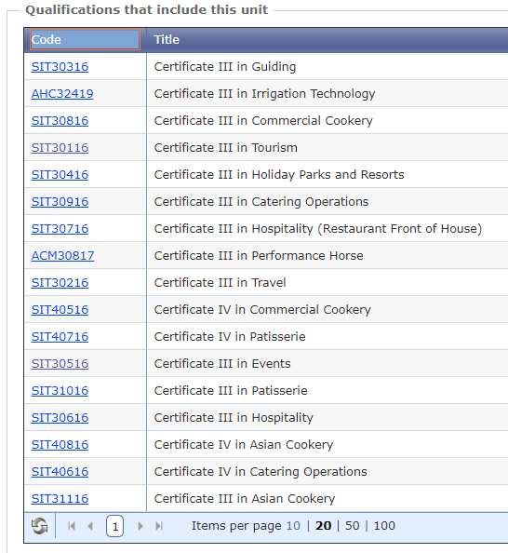
Determine the focus of the assessment tool
Identifying the context in which the Assessment Tool will be used
SITXCCS006 Provide service to customers
Vocational Training Area (VTA) - current as either a Core or Listed Elective unit within these 17 qualifications
The ‘story’ e.g. Activity Scenario
Is the ‘story’ one that is current within that industry area today?
Take into account ….
  industry feedback
  past outcomes
  level of understanding
  precedent context (other scenarios a learner may have benefited from encountering first)
Notes:
Time: 1 min
Select assessment methods that
take into account the context in which the assessment will take place,

Slide 28
Determine the focus of the assessment tool
Identifying the context in which the Assessment Tool will be used
What’s the Story?
Unit
Industry
Task
Task
Task
Industry Relevant Tasks that enable the learner to perform industry relevant skills and apply industry relevant knowledge
Are YOU the subject matter expert?
Are you working alongside a subject matter expert?
What information do you have at your disposal to work with when designing your tools and their associated industry relevant activities?
Notes:
Time: 1½ min
What’s the story? - The CONTEXT e.g. Scenario, Industry Relevant Job Role Situation, Activity etc.
Break this down into industry relevant tasks
Consider if YOU are the subject matter expert injecting your experience and expertise into this task or are you BEING INFORMED by an industry expert?

Slide 29

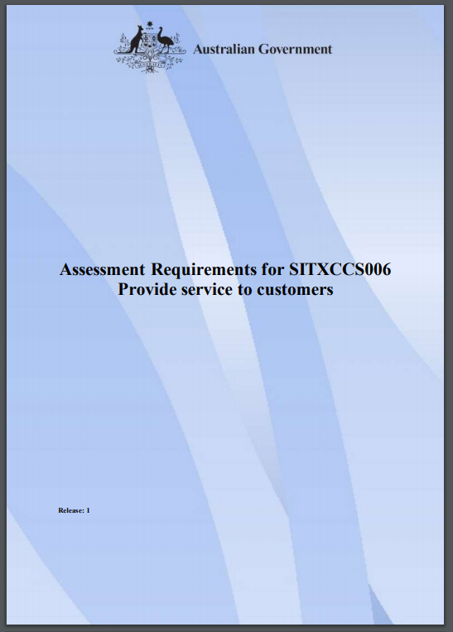

Determine the focus of the assessment tool
Industry Requirements and Relevant Contextualisation Guidelines and other related documentation
Training Package
Industry Information
Standards
Industry Reference Committees
Skills Service Organisations
Australian Industry Skills Committee
Industry relevant Assessment Task Activities
Notes:
Time: ½ min
We previously identified the context.
Let’s check back now ….
Meeting the vocational training area requirements
Showing what a training package asks for then….
Showing how the assessment author is dependent upon additional industry information to create an industry relevant project that puts that assessment into context

Slide 30
Job Role Context
Task Activity
Overall Job Task Outcomes
Task Instructions
Sub Task(s) Instructions
Author
Job Role
Notes:
Time: 1 min
Write the scenario
Think of a relevant Title
Consider the outcomes (evidence required)
Break the scenario down into clear instructions for learners
Break these down further into sub task instructions where relevant

Slide 31

Determine the focus of the assessment tool
Industry Requirements and Relevant Contextualisation Guidelines and other related documentation
Dimensions of Competency
Task skills – Learner performs the assigned task
Task Management Skills – Learner is required to organise the job and task specifics in order to perform the task
Contingency Management Skills – Learner is faced with decisions as a result of task progress and outcomes and required to solve problems
Job Role/Environment Skills – Learner performs task in accordance with the standards set by the organisation or associated with the workplace environment.
Putting the Unit Requirements into Context
Notes:
Time: 2 min
Task Skills are about undertaking a specific work task, such as using a photocopier, to the standard required in the workplace.
However, in the workplace tasks aren’t usually completed in isolation. They are combined with other tasks to achieve a work outcome. This may be using a number of different functions and trays on the photocopier to create a range of documents and outputs. This is called Task Management Skills.
What happens if something goes wrong? The photocopier jams, or it runs out of toner. What do you do to fix it? This is where Contingency Management Skills are demonstrated. The type of solution expected will vary at different qualification levels. A person performing at A-Q-F Level 1 would most likely report the problem to a supervisor, whereas a person performing at A-Q-F Level 3 or 4 may be the supervisor and therefore need to know how to clear the jam or replace the toner.
Finally, being able to deal with the responsibilities and expectations of the work environment are the Job Role or Environment skills. This includes:
working with others and communicating appropriately, maybe through determining what their photocopying requirements are for the print job you are completing
interacting with clients and suppliers, such as ordering toner cartridges or paper supplies; and
complying with standard company operating procedures, such as knowing what type of toner needs to be ordered and the approval process for paying for it.
Trainers and assessors need to integrate the dimensions of competency throughout the assessment process and ensure that learners meet these in order to be deemed competent.

Slide 32
Determine the focus of the assessment tool
Industry Requirements and Relevant Contextualisation Guidelines and other related documentation
Assessment Task Activity Scenario (Travel Agency)
Customer wishes to travel from Brisbane to Lima
Must travel via Los Angeles
Travelling with daughter (age 10) who does not have own passport
Must travel in next 3 months as passport expires in 4 months
Other than the specified destination there must be no more than one other stop
Stop wait times to be no longer than 2 hours
Wants vaccination information
Will not travel with Peru Airlines due to bad reviews
Wants a minimum of a 3-star hotel throughout the duration of the stay
Wants an itinerary of recommended things to do whilst there
Has a limited budget of $3,300.
Peru is a developing third world country with a limited tourism industry. It is noted that Peru allows entry to anyone with a passport that is valid for at least six months after the date of entry.
You are to provide at least 2 available options for this client so that she may select one that is suitable for her. You are to provide the customer with information pertaining to any critical information in accordance with the requirements of Peru border control and Global Star Travel Agency’s policy.
Requires research (TS)
Requires some level of negotiation and therefore care during verbal and non verbal communications (TMS)
Requires comparative analysis (TMS and CMS)
Considers specific customer related requirements to fulfill the service provision (TMS and CMS)
May require the seeking of support from a supervisor (CMS)
May require the use of specific software and other materials (JR)
Notes:
Time: 2 min
A Potentially More Difficult Scenario for the Learner to Undertake – prepares them for a wider range of challenges but ones that are more relatable to a job role being performed out there today.
As we have seen - The Activity Instruction tools must represent instructions and guidelines that enable the learner to competently perform or produce the required relevant evidence.
As we have seen - The evidence gathering tools must represent decision making rules that enable the assessor to make a fair, reliable and consistent assessment judgement to that effect.
May require …. RESEARCH TASK, COMPARATIVE ANALYSIS TASK, SIMULATED / WORKPLACE OBSERVATION TASK
Considers All 4 Dimensions of Competency

Slide 33

Determine the focus of the assessment tool
Other related documentation to inform assessment tool development
Legislated requirements specific to that subject matter area
  Blue Card
  White Card
  Licencing
Industry specific matter
  Impact upon the context and conditions of the assessment task
  Being ‘informed’ by industry representatives
  Pathways specific e.g. tasks directly complementing what ‘will’ be at the next level
Evaluative Feedback
  Outcomes from previous validation events
  Impact upon results
Notes:
Time: 1 min
As Slide

Slide 34
Design the Assessment Tool
Considering the Assessment Instruments
Assessment instruments are not referred to within the Standards or the supportive User Guide however, the term is used here within the TAEASS502 unit of competency and is often referenced in Vocational Education and Training.
ASQA’s determination: Source: ASQA FAQs
An assessment instrument is part of the assessment tool.
The assessment instrument is the documented activities developed to support the assessment method and used to collect the evidence of student competence.
An assessment instrument could include:
  oral and written questions
  observation/demonstration checklists
  projects, case studies, scenarios
  recognition or workplace portfolios
  workplace portfolios
An assessment instrument will include:
  the tasks to be administered to the student
  an outline of the evidence to be gathered from the candidate
  the evidence criteria used to judge the quality of performance (i.e. the assessment decision-making rules).
The assessment tool comprises the assessment instrument and the context and conditions of assessment. An assessment tool can also contain the administration, recording and reporting requirements of the assessment.
Notes:
Time: 1 min

Slide 35
Design the Assessment Tool
Considering the Tool Components including the Assessment Instruments
Context and Conditions
Industry Relevant Scenario
Physical Resources
Environment
Big picture description (Assessment Type)
Reasonable Adjustment Arrangements
The Assessment Tool
Student and Assessor Names
Unit Reference
General Need to Know Admin
Student Cohort/Year/Group Reference
Dates and Signatures
Resource References (where relevant)
Unique Tool Identifier
Version Control
Reference and Administration
Recording and Reporting Requirements
Overall Assessment Project Outcome
Interim Task Outcomes
Feedback
File References (where relevant)
Reporting Instructions
Top Level Information
Assessment Instruments
Task Instructions for Students
Administration and Support Instructions for Assessors
Evidence gathering criteria (decision making rules)
Benchmark responses
Notes:
Time: 2 min
Top Level Information – essentials of the tool
Doesn’t tell our end users what they need to know to achieve competency.
ASSESSMENT INSTRUMENTS – These are what provide a POINT OF DIFFERENCE between ONE TOOL and THE NEXT.

Slide 36

Determine the focus of the assessment tool
Establish evidence required to demonstrate competence
What do I have to DO?
What do I have to SUBMIT?
1. Establish what the required evidence is (as an outcome of the industry relevant activity being designed)
When by?
Who with?
Where?
What resources?
How many times?
2. Establish what enables the required evidence to be demonstrated by the learner at the aligned level of competence
Notes:
Time: 1 min What is the Student required to DO? What is the Student required to SUBMIT?
All assessment evidence falls under these two verbs and, when we simplify our end requirements into these two categories, it actually simplifies our understanding of the materials required to enable the practice.
If a Student is DOING, they are performing an activity that needs to be observed, watched, heard, witnessed, etc. This relates to activities that cannot be SUBMITTED.
If a Student is creating something tangible, such as a toolbox, or a cake, or a report, whether this be submitted in physical form or electronically, this is tangible evidence.
ARE THE ANSWERS TO THESE QUESTIONS CLEARLY WRITTEN WITHIN THE ACTIVITY INSTRUCTIONS?
RTOs often fill their assessment materials with unnecessary information such as:
Copied information from the unit of competency
Mapping of the tools and its instruments to the unit components
Information pertaining just to the assessors
Decision making rules – essentially, the answers
Unnecessary assessment system policy information
Looking at this from the perspective of the student, let’s ask ourselves why this information is in there.
Can access Unit Specification
Can access your mapping should you so wish as a separate document
Why would they need information that just pertains to the assessor?
Decision making rules are for decision makers e.g. The Assessor. Be Careful. Providing these to students is like giving them the answers to an exam. You may be hindering their ability to perform a workplace role without a step by step procedure of what to do. Unless the unit you are delivering is titled ‘How to follow a step by step procedure.’ they why would you do this? So, really think about this one.
Policy and procedure information is for the employed/contracted VET staff
What do the Students want to know? What information do they NEED to glean from your assessment materials.

Slide 37
Determine the focus of the assessment tool
Establish evidence required to demonstrate competence
SITXCCS006 Provide service to customers
1.1 Communicate with customers in a professional manner within designated response times using appropriate verbal and non-verbal communication.
Unit of competency
Means the specification of the standards of performance required in the workplace as defined in a training package.
ASQA Glossary
Standards of Performance
Performance Criteria
Audience = Assessment Author
Notes:
Time: 1 min
How would you measure this if you didn’t break down this criteria into smaller, more easily measurable components?
How would you structure these requirements into the context of a range of activity situations?
If I can bring you back to the verbal instructions concept. If the only documentation the learner has to rely upon is the unit criteria, this was meant for YOU, NOT for them. Your job as the assessment author is to unpack these standards along with a range of other considerations as we are addressing them today, for the purpose of enabling the learner, at their level of learning, to achieve competence.

Slide 38



Determine the focus of the assessment tool
Establish evidence required to demonstrate competence
SITXCCS006 Provide service to customers
1.1 Communicate with customers in a professional manner within designated response times using appropriate verbal and non-verbal communication.
Communicate with Customers ….
in a professional manner
within designated response times
use appropriate verbal communication
use appropriate non-verbal communication
Activity
Activity
Activity
Measurable components
Range of contexts
Additionally, this unit has a range of communication mediums which must be considered and a range of situations which must involve several factor considerations.
Notes:
Time: 2 min
How would you measure this if you didn’t break down this criteria into smaller, more easily measurable components?
How would you structure these requirements into the context of a range of activity situations?

Slide 39
Determine the focus of the assessment tool
Establish evidence required to demonstrate competence
SITXCCS006 Provide service to customers
1.1 Communicate with customers in a professional manner within designated response times using appropriate verbal and non-verbal communication.
Standard | Activity 1 | Activity 2 | Activity 3
1.1 Communicate with customers in a professional manner within designated response times using appropriate verbal and non-verbal communication.
Note: Activity components would be described within a mapping document to address specifically where within the assessment tools the demonstrated evidence can be located. Reference to the actual location with the tool is considered to be the application of best practice when mapping alignment.
Notes:
Time: 1 min
How would you measure this if you didn’t break down this criteria into smaller, more easily measurable components?
How would you structure these requirements into the context of a range of activity situations?

Slide 40
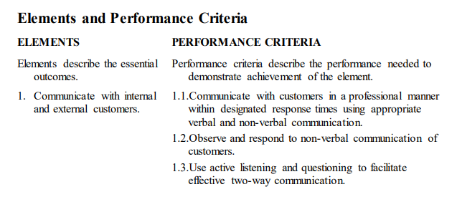
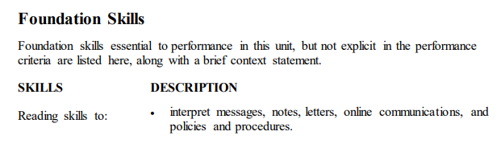
Determine the focus of the assessment tool
Access benchmark criteria
SITXCCS006 Provide service to customers
Assist yourself when building relevant Benchmark Criteria
Use ‘trigger’ words to ‘inform’ your decision making rules
Take into account the Australian Core Skills Framework to inform your understanding of the required Foundation Skills at this level
Notes:
Time: 1 min
Places within the unit that you can ascertain VERBS, TANGIBLE ITEMS, PROCESSES, DESCRIPTORS and ‘NUMBER OF TIMES’ to use to form your BENCHMARK CRITERIA.
This slide: Elements and Performance Criteria and Foundation Skills examples.

Slide 41
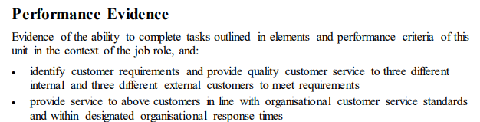
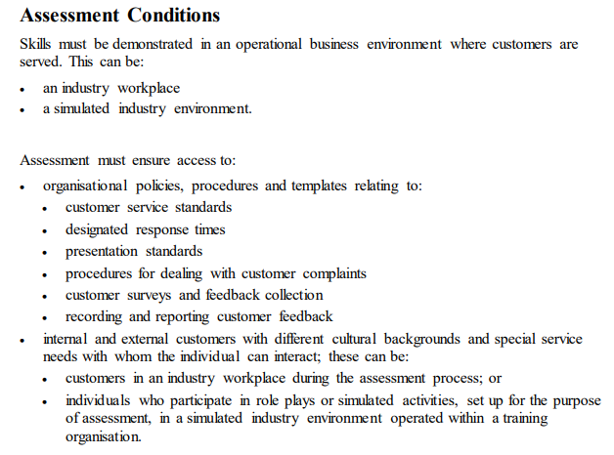
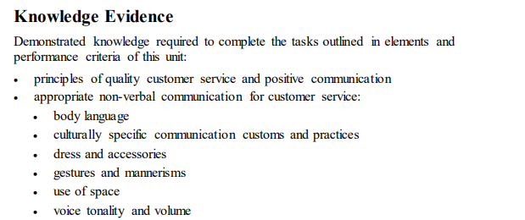
Determine the focus of the assessment tool
Access benchmark criteria
SITXCCS006 Provide service to customers
Notes:
Time: ½ min
Places within the unit that you can ascertain VERBS, TANGIBLE ITEMS, PROCESSES, DESCRIPTORS and ‘NUMBER OF TIMES’ to use to form your BENCHMARK CRITERIA.
This slide: Performance Evidence and Knowledge Evidence and Assessment Conditions Examples.

Slide 42
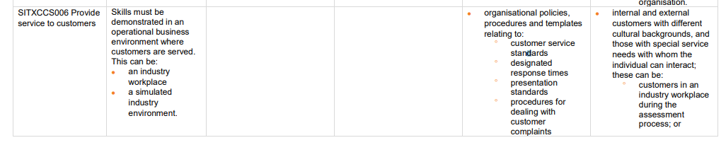
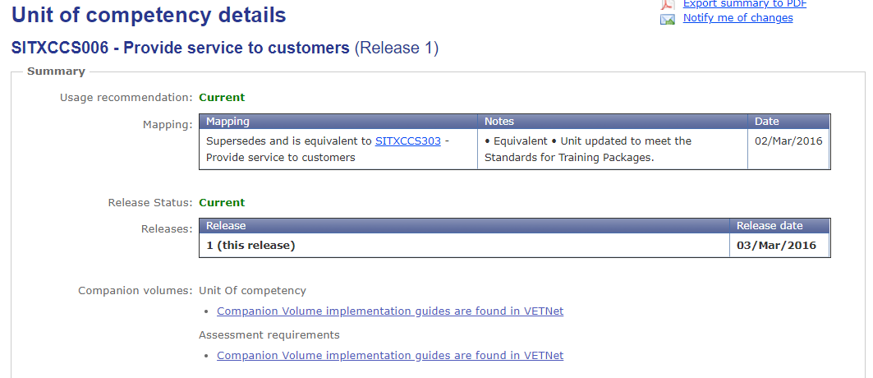
Determine the focus of the assessment tool
Access benchmark criteria
SITXCCS006 Provide service to customers
Notes:
Time: ½ min
Places within the unit that you can ascertain VERBS, TANGIBLE ITEMS, PROCESSES, DESCRIPTORS and ‘NUMBER OF TIMES’ to use to form your BENCHMARK CRITERIA.
This slide: Companion Volume Examples.

Slide 43
Design the Assessment Tool
Selecting Assessment Methods …. that support the collection of defined evidence
Tangible
Physical/Electronic Product:
Documentation (paper or electronic)
Table
Cake
Tool box
Photographs
Artwork
Music piece
Computer program
Physically submitted
Consider product components
Observed Performance
Observable Behaviour:
Practical work
Role play
Active response
Mentoring
Preparatory work
Group discussion
Service
Stage Performance/Presentation
Not Physically submitted
Consider the behaviours to be observed
What type of evidence is being produced?
Notes:
Time: 1 min
As Slide.
Define the evidence
Consider HOW you are collecting this evidence

Slide 44
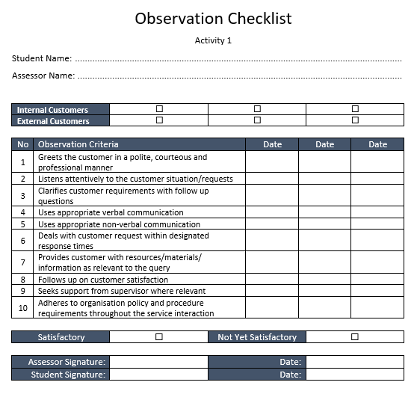
Task Activity with Observation Checklist Sample
During the assessment design process consider the observable behaviours to be demonstrated by the learner to ensure competent performance in line with the instructed assessment activity:
For instance:
Evidence gathering tools are to be entirely representative of the intended practice and methods required that enable fair, reliable and consistent assessment judgements.
Assessment criteria (decision making rules) must represent what the assessor will need to observe.
Break the criteria down into the small performance components so that each can be independently, and clearly, assessed on its own merits.
Notes:
Time: 1/2 min
Let’s be clear. It is the assessment author who is writing the assessment task activity.
The assessment task activity is NOT the performance criteria within the unit. They are the Standards which we, as assessment authors, use to design and culminate our industry relevant assessment design activities.

Slide 45
Observation Checklist Sample
Assessment Task Activity Scenario (Travel Agency)
Global Stars Travel Agency require you to work as their temporary first point of call customer service representative within their Brisbane offices. The position requires you to adhere to the organisation’s Customer Service Policy and Procedure apply the expected customer service standards at all times. You are to greet and assist customers with their requests in a polite, courteous and professional manner, within an appropriate timeframe respective of the complexity of the customer’s request and in accordance with the organisation’s designated response times.
Customer requests may be received via the following mediums:
Telephone call
Live Chat Message via the Organisation Website
Direct email
Face to face communication within the office
In each instance, establish a rapport with the customer and clarify your understanding of their request to ensure you are seeking the right information on their behalf and in a manner that meets their needs. Seek to acquire an understanding of the customer’s satisfaction upon completion.
Should the customer’s request require the assistance of your supervisor you are to seek their support immediately to support completion of the request to the customer’s satisfaction.
Notes:
Time: 1½ min
An Evidence Gathering Tool, such as this Observation Checklist, represents ALL of the things that YOU expect a learner to perform as a result of your CLEAR task instructions here on the left hand side.
ANIMATE ARROW These Decision Making Rules (Checklist Criteria) must represent those expectations to ENABLE the learner to meet the requirements of the UNIT COMPONENTS that YOU have aligned to this particular activity.
Collectively they REPRESENT the task and what it has INSTRUCTED THE LEARNERS TO DO. ☺
An Evidence Gathering Tool, such as this Observation Checklist, represents ALL of the things that YOU expect a learner to perform as a result of your CLEAR task instructions here on the left hand side.
ANIMATE ARROW These Decision Making Rules (Checklist Criteria) must represent those expectations to ENABLE the learner to meet the requirements of the UNIT COMPONENTS that YOU have aligned to this particular activity.
Collectively they REPRESENT the task and what it has INSTRUCTED THE LEARNERS TO DO. ☺
PROVIDE A SERVICE TO CUSTOMERS
Travel Agency
First point of call
Receive customer requests in a manner of ways
Focus is on how they deal with those customers
Reaching a point of customer satisfaction
POINT OF THIS SLIDE ….
They can read the scenario in their own time. Point is, the evidence gathering tool (or tools) and its associated decision making rules (instruments used to gathering evidence) directly align to one another.
What you have asked the STUDENTS to DO IS what you are assessing.
It is NOT the standards of the unit. It is the task scenario which, in itself, ENABLES the learner to meet the requirements of the unit in a way which represents the industry relevant job role context that has been provided.

Slide 46



Design the Assessment Tool
Selecting Assessment Methods …. that support the collection of defined evidence
Written Questions
Defined Written Response
Documentation:
Written Questions (Student)
Benchmark Responses (Assessor)
Verbal Questions
Defined Verbal Response
Documentation:
Written Questions (Assessor)
Benchmark Responses (Assessor)
Interview Questions
Defined Verbal Criteria Range
Documentation:
Discussion areas (Assessor)
Benchmark criteria (Assessor)
What type of evidence is being produced?
Notes:
Time: 1½ min Is it Q&A? Many methods of Q&A. Written questions, verbal questions, interviews.
In each instance there would be benchmark responses. What is the correct response? To ensure quality moderation of assessment judgements across assessors, a guide of acceptable responses must be provided where questions are involved. Most checklists list criteria that must be met. A list of benchmark responses often provide a range of acceptable responses pertaining to situation type questions.
Method that is relevant to the type of questioning activity e.g.
Written questions – submit response
Verbal questions – who writes down the responses?
Interview – different to verbal questions exercise in that a range of verbal responses are required to accurately describe or account for a given situation, as presented within the question. Benchmark responses would list a range of items for ‘inclusion’ within the learner’s responses meaning that, the student could say 50 words, they could say 500 words, but as long as items a), b) and c) are included within that response then they have met the criteria for that question.
These responses are more general to the learner’s situation e.g. describe your role within the group project:
What role they played.
What they had to do as part of that role.
Should the learner simply respond with, I was the “minute taker” (for example) within the group, they have only answered half of the acceptable response. The assessor can then prompt the learner which another question to say, can you describe for me the duties you had to perform as a part of that role? Then hopefully, the learner would answer component b) of that acceptable benchmark response.

Slide 47



Design the Assessment Tool
Selecting Assessment Methods …. that support the collection of defined evidence
Student
Assessor
Direct Assessment
Interim Party
Notes:
Time: ½ min
Is it directly demonstrated?
Direct assessment – where the assessor directly assesses the evidence either through observation or the submission of work that is made directly to the assessor. A direct judgment can be made in this regard.
Is it collected via other means e.g. third party. – where the assessor is dependent upon information gathered by another person.
The assessor combines this information with other directly gathered and assessed outcomes to make an overall assessment judgement.

Slide 48
Design the Assessment Tool
Selecting Assessment Methods …. that support the collection of defined evidence
What does this assessor need to know from the interim party to assist the assessment judgement?
NOT …. What decision making rules can I give the third party?
For example:
Please describe the student’s conduct and manner throughout today’s service period. Please tick all that apply:
Courteous
Helpful
Proactive
Sought your assistance
Customer was happy with service
Used appropriate language
Made customer feel welcome and at ease
Wore appropriate clothing/uniform
Arrived on time
Draft a checklist of Third Party Items
Instructions to Third Party must include HOW they are to use the tool
Notes:
Time: 1 min
As Slide.

Slide 49
Design the Assessment Tool
Selecting Assessment Methods …. that support the collection of defined evidence
Assessment Task Activity
Product(s)
Observable Behaviours
Questions
Single Capture Checklist
(Multiple Methods)
Evidence Gathering Tool
Ensure that the instructions to the Assessor sufficiently describe the complexity of the assessment tool and how it is to be used.
Notes:
Time: 1 min
Combination – sometimes the task may only be fulfilled through a combination of these things and this will often culminate in either a portfolio of work or structure activities, the components for which would be assessed using a variety of methods. Depending upon the context, timing and situation of the activities, the assessor may decide that each of these components are to be assessed separately or that assessment checklists may be constructed to represent a variety of methods eg.
Observation with verbal questions
Portfolio checklist comprising of written work outcomes, observation of video recording submission and observation of role play.
What is fair to both the learner – sufficiently and appropriately represents the evidence they have performed and/or submitted
What is fair to the assessor – provides the assessor adequate opportunities to gather the evidence efficiently and effectively without hindrance
WHY WOULD YOU DO THIS? If the submission of these three items occur at different times it is best to keep them separated.
If they are occurring simultaneously such as,
EXAMPLE: Student is building a cubby house. You are observing the build, you are asking the student questions as they build and they are submitting the cubby house all as one outcome of one single task, then by all means, do this! ☺

Slide 50

Design the Assessment Tool
Selecting Assessment Methods …. that support a learner’s claim to recognition
Start from the job and work back to the unit
RPL Tool Kit
Self-Evaluation
Interview/Questions/Competency Conversation
Demonstrations/ Observations
Supplementary Third Party Evidence
Develop a picture of the job/role the unit enables a learner to demonstrate.
What evidence can the candidate provide for this?
What types of evidence can satisfy you of sufficient demonstration of skills and knowledge?
Unit
Job
Notes:
Time: 2 min Collection of evidence that represents KNOWLEDGE and SKILL that has already been acquired.
The PURPOSE of the ASSESSMENT ONLY pathway is NOT to provide the candidate with assessment tools that you have developed based on an industry relevant scenario.
The point is, they have ALREADY DONE THIS.
So, YOUR FOCUS is on developing tools that will ENABLE you to RECORD evidence that the candidate provides from their job role(s) and align this to the requirements of the unit.
STILL taking into account the Principles of Assessment and Rules of Evidence (which we shall cover in tomorrow’s webinar session).
Mel, speak to the TYPES of EVIDENCE GATHERING.
Other notes from John.
Select assessment methods that
Support a learner’s claim to recognition
Start from the job and work back to the unit
Develop a picture of the job/role the unit enables a learner to demonstrate.
Think about the job objectively and don’t become a victim of your own expertise – may lead to assessment NOT meeting the principles of assessment – may not be reliable or fair
What does the job require/entail?
Think about the big picture job.
What evidence can the candidate provide for this.
What types of evidence can satisfy you of sufficient demonstration of skills and knowledge?
Then, bring this back down to the unit criteria – the evidence provided by the candidate will either more than cover most of the requirements if not all and, if not all, present gaps to be addressed. Between yourself as the assessor and the student you can discuss other potential sources of evidence that most adequately address those gaps which may be more of the same examples or some other type of evidence.
Be prepared to accept the types of evidence presented to you.
Be clear to the learner of the types of evidence you can accept and assess.

Slide 51
Design the Assessment Tool
Selecting Assessment Methods
…. that meet the principles of assessment
will this tool accurately represent the component requirements e.g. unit, industry, and other contextual considerations at the relevant AQF level? Can you map this tool and its associated method to show clear alignment?
Principles of Assessment
Valid
Reliable
Flexible
Fair
Means that one size does NOT fit all. It isn’t fair to assume all learners will be able to achieve competency using the tools. Being fair means showing no bias or prejudice across the tools and adapting applicable methods to enable fairness across the range of learners, depending on their identified needs. How can you ensure that this tool/method is adaptable or that there are alternative tools in place?
The tool must present reliable instructions that are clear, consistent and easily understood that enable the learner to demonstrate satisfactory evidence and enable the assessor to make ‘correct’ judgments using the assigned method.
Does the tool allow for foreseen and unforeseen adjustments? Are there other methods in which the activity can be assessed so as not to disadvantage any learner.
Notes:
Time: 2 min (Including Next Slide)
Valid – Principle of Validity (Not the principle rule of evidence)
This means – do your tools stack up to accurately represent what is being asked for from the unit of competency? HOW are you providing evidence of this? MAPPING TOOL.
Reliable – Is it a Reliable tool? What does that mean?
Are the INSTRUCTIONS reliable? Are they asking of the student evidence that is ‘required evidence’. Be careful of your language, your words – use DUMMY reader to give you feedback on THEIR INTERPRETATION of what is being asked for.
Are the rules and benchmark responses reliable? They can be valid but still not be reliable – how? They can meet what the unit is asking for BUT they could be interpreted differently across assessors. What evidence does the assessor believe they are gathering?
Going back to those performance criteria standards again – break these down – must be CLEAR. Use DUMMY reader again.
Gain feedback from any students who use the tools to glean a wider range of interpretations to inform the language and wording used.
Fair – How will you ensure that this tool is adaptable? MEL – PROVIDE SOLUTION HERE.
Flexible – Are there other ways in which the activity can be undertaken and/or presented? MEL – PROVIDE SOLUTION HERE.

Slide 52
Design the Assessment Tool
Considering how assessment instruments are administered
The application of task requirements in context and over time, taking into account ….
What
Assessment Activities/Tasks
Outline of the Evidence to be gathered
Criteria to judge evidence against
When
Scheduling (Theory steps prior to practical performance)
Methods applied (may be dependent upon location access and third party availability)
Pre-requisite achievement
How
Platforms used for communication, issue and application
Face to face, via a third party, online etc
By whom
The assessor
The third party
Other e.g. pre-determined progressive online access
What is given to the students, when, how and by whom?
Notes:
Time: 1 min
ASQA
the tasks to be administered to the student
an outline of the evidence to be gathered from the candidate
the evidence criteria used to judge the quality of performance (i.e. the assessment decision-making rules).
Student Instructions
Tell them what they need to know
Clearly, succinctly, procedurally with all relevant and pertaining information
What they must DO and what they must SUBMIT
What they are asked to demonstrate MUST reflect the requirements of the unit (Valid)
The way the instructions are written and presented MUST inform them with no doubt what they are required to demonstrate (Reliable)
Assessor Instructions
Tell them what they need to know
Clearly, succinctly, procedurally with all relevant and pertaining information
What they must DO WHILST students are preparing and demonstrating their evidence
The way the instructions are written and presented MUST inform them with no doubt what they are required to do and how (Reliable)

Slide 53
TAEASS502 Design and Develop Assessment Tools – Two Parts
Application: “Design and develop assessment tools used to guide the collection of quality evidence, including their application in formative, summative and recognition of prior learning (RPL) assessment.”
Part One (Now)
Determine the focus of the assessment tool
Design the assessment tool
Part Two (Tomorrow)
Develop the assessment tool
Review and trial the assessment tool
Notes:
Time: ½ min
What we are covering tomorrow ….

Slide 54
WHAT WE HAVE COVERED
The purpose of Assessment Tools – why do we need them?
Applying the right assessment methodology
Administering the component instruments
Knowing who your target audience and end users are
Designing the tools – how do we begin?
Understanding criteria and contextualisation
Notes:
Time: ½ min

Slide 55

ANY QUESTIONS?

Slide 56

WHAT HAPPENS NOW?
WITHIN 48 HOURS, YOU WILL RECEIVE AN EMAIL INCLUDING:
A Statement of Attendance
A link to event feedback survey
Access to the WMV recording of the webinar for three months
PDF copy of the PowerPoint
PDF transcript of Chat Q&A
BONUS RESOURCES
A range of resources to assist with your Assessment practices

Slide 57
UPCOMING EVENTS
Tomorrow’s TAE PD Week webinars…
2 December @ 11am: Webinar
The Design and Development of Assessment Tools - Part 2
2 December @ 1pm: Webinar
Unpacking Training Packages to Meet Client Needs
*All webinar times are shown in AEST (QLD time)

Slide 58
CONTACT US
Velg Training
1/52 Jeffcott Street
Wavell Heights QLD 4012
P 07 3866 0888
E webinar@velgtraining.com
W velgtraining.com

Slide 59
THANK YOU FOR YOUR COMPANY
We really hope you enjoyed engaging with Melanie Alexandra for your webinar today.
If you have any queries or feedback relating to today’s topic, or any general questions regarding your role within the VET sector, do not hesitate to contact the team at Velg Training.
Phone: 07 3866 0888
Email: melanie@velgtraining.com.au
Website: www.velgtraining.com
LinkedIn: Melanie Alexandra

