Slide 1
Upcoming webinars
Providing Evidence of TAE Currency
June - July
Systematic Validation of Assessment: This is your conscience speaking
16 June 2017
June Members Lunch Box
19 June 2017
Reviewing your Certificates and Statements of Attainment
21 June 2017
Documenting the Volume of Learning in the Training and Assessment Strategy
5 July 2017
Notes:
An outline of the post-event process, as read by Velg Training’s webinar facilitator.

Slide 2
Validation and Moderation
What’s the difference?
(Webinar)
© Velg Training – Version 1.0, January 2017

Slide 3

About the Presenter
John Dwyer is a trainer and consultant with experience in school education and Vocational Education and Training (VET) spanning more than 60 years. He brings extensive registered training organisation (RTO) experience. He has developed and delivered a range of workshops on competency-based training and assessment, assessment tools, recognition of prior learning (RPL), moderation and validation processes, and activities relating to RTO compliance.
John works for Velg Training as a senior consultant for the VET sector. He is currently a member of the industry reference committee (IRC) for the Training and Education Training Package.
John Dwyer
Consultant
Velg Training
T 07 3866 0888
E john@velgtraining.com
W velgtraining.com

Slide 4

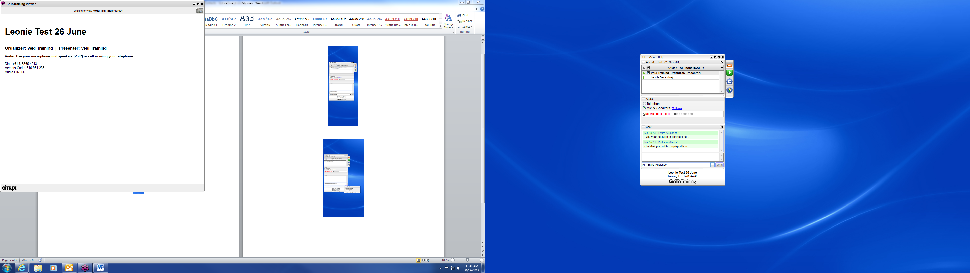
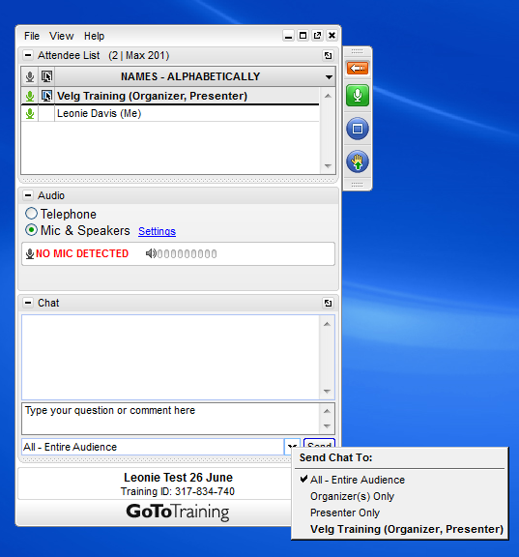
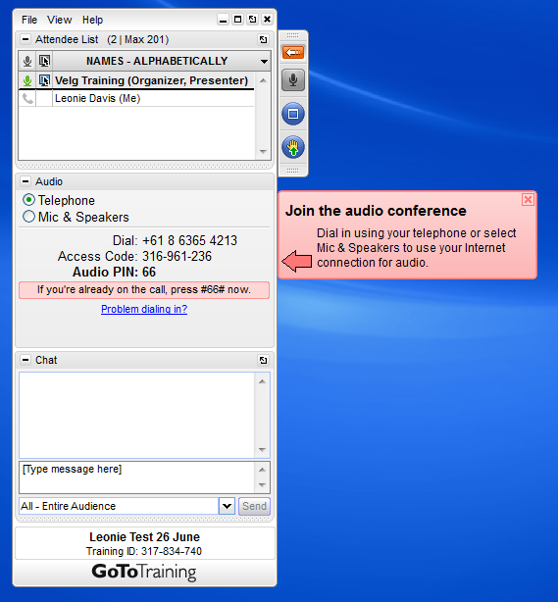

Control Panel

Slide 5

Audio test
Hands up who can hear me?
Raise your hand to indicate

Slide 6
Who’s online today
POLL

Slide 7
Webinar Overview
1
2
Validation of training products
3
Moderation – a quality control process
Validation – a quality review process
Industry Validation – requirements and processes
Internal Validation – requirements and processes
Validation of learner outcomes
Recording validation outcomes
Moderation of learner outcomes
Validation and Moderation compared

Slide 8
Validation

Slide 9
Validation - Let’s start with a definition
Validation is a quality review process.
It involves checking that the assessment tool/s reliably produced valid, sufficient, current and authentic evidence to enable reasonable judgements to be made as to whether the requirements of the training package or VET accredited courses are met.
It includes reviewing a statistically valid sample of the assessments and making recommendations for future improvements to the assessment tool, process and/or outcomes and acting upon such recommendations.
Source: Users’ Guide - Standards for Registered Training Organisations (RTOs) 2015 (Glossary)
(Adapted as above)

Slide 10
Industry validation
Industry relevance
1.5 The RTO’s training and assessment practices are relevant to the needs of industry and informed by industry engagement.
Range of strategies
1.6 The RTO implements a range of strategies for industry engagement and systematically uses the outcome of that industry engagement to ensure the industry relevance of:
    its training and assessment strategies, practices and resources; and
    the current industry skills of its trainers and assessors.

Slide 11
Industry validation
What industry consultation processes are you using?
With whom do you consult and about what?
When and how?
How do you record these consultations?
What impact does this consultation have on your assessment processes and products?
Put up your hand if you would like to talk with us.
OR
Enter your comments in the chat window.

Slide 12
Industry validation/consultation
The purpose is to ensure that your assessment processes make sense to industry.
Industry engagement, may include, but is not limited to, strategies such as:
Partnering with local employers, regional/national businesses, relevant industry bodies and/or enterprise RTOs
Involving employer nominees in industry advisory committees and/or reference groups
Exchanging knowledge, staff, and/or resources with employers, networks and industry bodies.
Developing networks of relevant employers and industry representatives to participate in assessment validation
Embedding staff within enterprises
Networking in an ongoing way with industry networks, peak bodies and/or employers
Record Outcomes
But only in ways that benefit your business. Avoid generating documents “just for the auditor”.

Slide 13
Industry validation
Independent validation of training and assessment (TAE) qualifications
  From 1 January 2016, to deliver any AQF qualification or assessor skill set from the Training and Education Training Package (or its successor), the RTO must have undergone an independent validation of its assessment system, tools, processes and outcomes in accordance with the requirements contained in Schedule 2 (and the definitions of independent validation and validation).
Note this applies only to TAE Training Package Products
Independent validation means that the validation is carried out by a validator or validators who:
is/are not employed or subcontracted by the RTO to provide training and assessment; and
have no other involvement or interest in the operations of the RTO.

Slide 14

What about internal validation?
Encourage deep thinking about assessment procedures
Adopt a common understanding
Validation
involves a professional conversation between colleagues
Protect the integrity of national qualifications

Slide 15
Internal validation of assessment
Enables assessors to develop a shared understanding of the requirements of specific (units from) Training Packages
the nature of evidence
the assessment guidelines
how evidence is collected
the relevant competency standards
The basis on which assessment decisions are made

Slide 16
Systematic internal validation?
1.9 The RTO implements a plan for ongoing systematic validation of assessment practices and judgements that includes for each training product on the RTO’s scope of registration:
when assessment validation will occur;
which training products will be the focus of the validation;
who will lead and participate in validation activities; and
how the outcomes of these activities will be documented and acted upon.

Slide 17
Systematic internal validation
  1.9 The RTO implements a plan for ongoing systematic validation of assessment practices and judgements …
  This means (1) that a planned and repeatable approach to validation is in place and (2) that this leads to the continuous improvement of assessment practices and judgements.
1.10 For the purposes of Clause 1.9, each training product is validated at least once every five years, with at least 50% of products validated within the first three years of each five year cycle, taking into account the relative risks of all of the training products on the RTO’s scope of registration, including those risks identified by the VET Regulator.

Slide 18

Develop and implement a plan
Decide which approach to validation best suits the RTO
Agree
on the procedures to be followed for validation as well as the forms that will be used
Determine
  when and how often validation will occur
  what assessment tools will be validated
  who will participate
Confirm
whether assessors require support or PD in validation processes

Slide 19
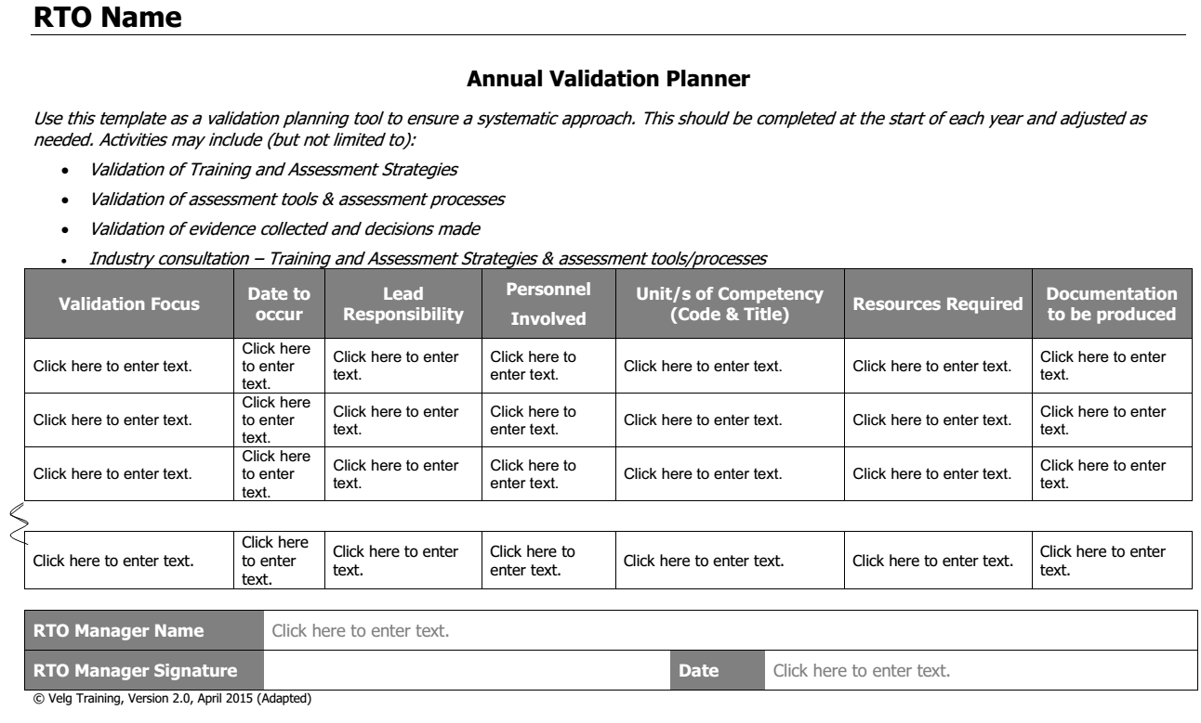
Internal validation – Annual Planning

Slide 20
Internal validation – Activity Planning
RTO Name |  |  |  |  |  |  | Date
Training Package Code |  |  | Training Package Name
Qualification Code |  |  | Qualification Name
Competency Code/s |  |  | Competency Name
What is the focus of the validation activity? | What principles / rules apply? | What methods / approaches will you use? |  | Who will you involve in the validation activity? |  | What resources will you need? | How will you record the activity? |  | How will you promote follow up?
Plan Developer |  | Date
You could choose a single target or decide to validate a mix of the following:
Assessment processes
Assessment tools
Assessment evidence
Assessment judgements
Processes and Tools
Principles of Assessment
Evidence and Judgements
Rules of Evidence
Notes:
What will you validate? (target - process, tools, evidence, judgement?)
What principles/rules apply to validation?
What methods/approaches will you use?
Who will you involve in the validation?
What resources will you need?
How will you record the activity?
How will you ensure/promote follow-up?

Slide 21
Internal validation - People
1.11 For the purposes of Clause 1.9, systematic validation of an RTO’s assessment practices and judgements is undertaken by one or more persons who are not directly involved in the particular instance of delivery and assessment of the training product being validated, and who collectively have:
    vocational competencies and current industry skills relevant to the assessment being validated;
    current knowledge and skills in vocational teaching and learning; and
    the training and assessment qualification or assessor skill set referred to in Item 1 or 3 of Schedule 1.
Industry experts may be involved in validation to ensure there is the combination of expertise set out in (a) to (c) above.

Slide 22
Internal validation - Who could be involved in assessment validation?
Industry
Other (e.g. Quality Experts)
Employers
Technical and subject matter experts
Candidates
Trainers / teachers
Assessors
Evidence providers
Who does your RTO involve?

Slide 23
Internal validation - assessment processes, tools and methods
Assessment Process
Assessment Tools and Methods
Assessment Evidence
Assessment Judgement
CONTINUOUS
IMPROVEMENT

Slide 24
Internal validation - assessment processes, tools and methods
The assessment process, methods & tools enable the candidate to provide evidence that would meet the Standard
Check the requirements of the (unit) training package
Number of assessment methods
Training approach and course structure
www.training.gov.au

Slide 25
Internal validation - assessment processes, tools and methods
Refer to the AQF; Rules of evidence; Principles of assessment
Knowledge
Multiple choice
Short answer, etc.
Performance
Tasks; etc
Plan to check purchased resources.
Information to candidates, assessors & third parties
Don’t assume your money is well spent
Benchmark criteria

Slide 26
Internal validation - evidence and judgements
Assessment Process
Assessment Tools and Methods
Assessment Evidence
Assessment Judgement
CONTINUOUS IMPROVEMENT

Slide 27
Internal validation - evidence and judgements
Confirm assessment methods and review methods and tools
Validity and Reliability
Collecting evidence & making the judgement
Feedback on assessment , re-assessment & appeals
Appropriate-ness for candidates
Capacity for flexibility

Slide 28
Internal validation – evidence and judgements
  Examples
  ‘Question 8 is answered incorrectly more than any other question’
  (A validation outcome, identifying a weakness in the assessment tool that hopefully leads to an improvement in the tool.)
  ‘One assessor considers Question 3 should have a different benchmark answer’
  (A validation outcome – to improve the way the benchmarks are written; linked to the principle of reliability.)
  ‘Feedback indicates the type of assessment is not effective’
  (A validation outcome - this is the kind of response that you might get when validating an assessment process with industry.)
  Different assessors appear to be making different judgements about this question.
  (A validation outcome - this is the kind of issue that might arise if there is not reliability among assessors.

Slide 29
Internal Validation Approaches
Approaches for Validation | Components of the assessment strategy to be validated
 | Assessment process | Assessment tools | Evidence | Assessment judgement
 | A | B | C | D
Assessor networks | X | X | X | X
Assessment Panel | X | X | X | X
Assessment tool bank |  | X
Bank of assessment exemplars and benchmarks |  | X | X
Benchmarking | X | X |  | X
Client satisfaction surveys | X |  |  | X
Field testing, trialling and piloting |  | X
Independent validator | X | X | X | X
Information for assessors | X |  | X | X
Internal Audits | X | X | X | X
Lead assessor | X | X | X | X
Mechanisms to support professional judgement |  |  | X | X
Mentoring | X |  | X | X
Moderation meetings | X | X | X | X
Peer review | X | X | X | X
Professional development | X | X | X | X
RTO Self assessment | X | X | X | X
Sampling |  | X | X | X
Specialist assessor |  | X | X | X
Team assessment | X |  | X | X
Source: Learning and assessment strategies - Part two: Resource Guide

Slide 30

Assessment Panel
Composed of individual assessors from the same RTO, perhaps supported by others, who meet to:
Interpret
and promote a common understanding of units of competency and Training Package requirements
Determine
reasonable adjustment
Critique
and sign off assessment tools
Develop
benchmark criteria for expected responses
Advise
on professional development for assessors
Review assessment processes
Provide
a network of mentors and coaches for assessors

Slide 31

Peer Review
Involves assessors from the same RTO observing each other assessing and then providing structured and specific feedback on the overall conduct of assessment use of the assessment tools and the range of evidence gathered, i.e.:
    Assessment planning interview with the candidate
    Evidence gathering tools selected
    Assessing competence
    Evidence collected; and
    Assessment judgement
Involves assessors from the same RTO reviewing developed assessment tools and providing structured and specific feedback about them; i.e.
validity
reliability
flexibility
fairness
Can be implemented formally (as part of the RTOs practices); or
informally (agreement between colleagues)
May involve pairing a more experienced assessor with a less experienced assessor as part of a mentoring process often used for new assessors

Slide 32
Internal validation – Linked to review
2.2 The RTO:
...
systematically evaluates and uses the outcomes of the evaluations to continually improve the RTO’s training and assessment strategies and practices. Evaluation information includes but is not limited to quality / performance indicator data collected under Clause 7.5, validation outcomes, client, trainer and assessor feedback and complaints and appeals.

Slide 33
Recording validation outcomes
  Record and implement
  Moving forward
  Report on outcomes
  Avoid generating documents ‘just for the auditor’
How do you record the outcomes of your validation activities?
Put up your hand if you would like to talk with us.
OR
Enter your comments in the chat window.

Slide 34
What documentation is required?
Regardless of the assessment validation method used, the RTO must have a systematic validation approach and maintain records of the validation processes.
The forms of evidence that show validation has taken place may include:
records of meetings where validation is covered (agendas, minutes, action plans);
feedback from clients (student and/or employer satisfaction surveys: notes recording feedback from face-to-face or telephone interviews);
records of benchmark activities;
examples of materials used in reviewing, comparing and
evaluating tools (quality criteria, review checklists).

Slide 35
What about Moderation?

Slide 36
Moderation - a definition
Moderation is a quality control process.
The process of bringing assessment judgements and standards into alignment.
It is a process that ensures the same standards are applied to all assessment results within the same unit(s) of competency.
It is an active process in the sense that adjustments to assessor judgements are made to overcome differences in the difficulty of the tool and/or the severity of judgements.
Source: AQTF Users’ Guide to the Essential Conditions and Standards for Continuing Registration, 2010
Moderation does not appear in the Glossary to the Users’ Guide – Standards for Registered Training Organisations (RTOs) 2015

Slide 37
Moderation processes
Adjustments achieved by discussing and reaching agreement before results are finalised.
QUALITY CONTROL

Slide 38
Assessment Moderation
When?
During assessment
For example: two assessors working together to consider the evidence and agree on a judgement
(This sometimes happens with some RPL processes/and/or ‘product- based’ assessment like portfolios.)
After assessment
But before the candidate is advised of the outcome
For example: where assessors look at the same evidence with a view to confirming or changing the original judgement
(This is why moderation is a quality control process – focussed on valid and reliable assessment outcomes.)
.
  NB: You can validate after assessment where you look at the consistency of judgements (after the results have been given to the candidate). At that stage however, you cannot change the judgement; what you might be able to do is to improve the quality of future judgements. This is a quality review process aimed at improvement; hence it is “validation”.

Slide 39
Moderation – Sample assessment tool
Underpinning Knowledge Assessment
Question 1
Recommend three (3) examples of communication techniques that can be implemented to accurately assess customer needs.
Moderation will confirm if the learner has provided answers that correspond to the benchmark criteria
AND
if the assessor has used the criteria in making a judgement
BEFORE
the learner is given a result.
Marking Guide / Benchmark Criteria
Question 1
Candidate’s response must recommend three (3) communication techniques from the list below:
Analysing customer satisfaction surveys
Analysing quality assurance data
Conducting interviews
Consultation methods, techniques and protocols
Seeking feedback to confirm understanding
Summarising and paraphrasing
Additional response option identified during moderation

Slide 40
Moderation – Sample assessment tool
Workplace Observation and Portfolio
During the Observation Period did the candidate demonstrate the required skills for this unit of competency: | Yes / No | Date | Indicate how this professional judgment was made
Three (3) examples of communication skills to: Communicate effectively with personnel and clients at all levels Articulate customer service strategies Evidence may include examples of: Analysing customer service surveys and data Conducting interviews, consultation, recommendations, questioning and feedback Minutes of meetings Training feedback forms
Three (3) examples of how the candidate applied interpersonal skills : To build relationships with customers To establish rapport Evidence may include examples of: Testimonials from customers Performance appraisals from supervisors Feedback from management
Moderation will confirm that the learner has provided or demonstrated all of the required evidence
AND
that the assessor has provided adequate detail
BEFORE
the learner is advised of the outcome.

Slide 41
Validation & Moderation compared

Slide 42
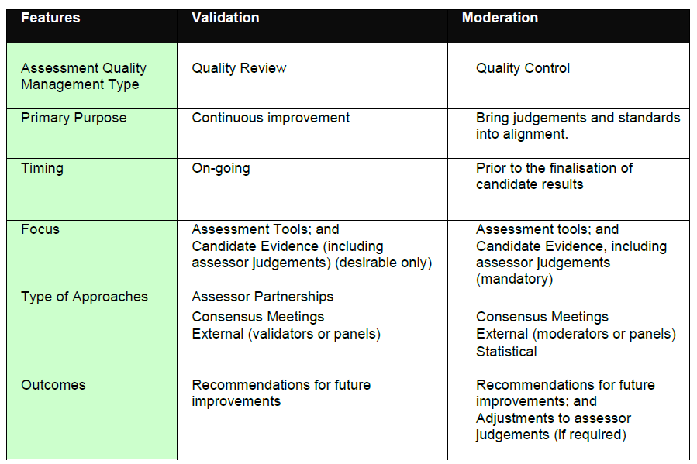
Validation and Moderation compared
Source: “Implementation Guide – Validation and Moderation; NQC; 2009; p.8

Slide 43

What does it all mean in practice?
Four Validation Targets
Moderation
Assessment Process
Assessment Tools and Methods
Assessment Evidence
Assessment Judgement
Adjustments achieved by discussing and reaching agreement before results are finalised.
CONTINUOUS IMPROVEMENT
QUALITY CONTROL

Slide 44
CHECK - Validation OR Moderation?
Scenario:
XYZ RTO hears a number of complaints that different assessors seem to be looking for different things in response to questions.
Bill is doing a RPL assessment of Mary and he decides to check with Sarah, another assessor, about the status of some of Mary’s evidence.
A reviewer notices that a number of items in assessment tools for a particular group do not appear to have been assessed even though the learners have been judged competent.
A major employer client complains that learners completing a course do not appear to have the skills and knowledge he requires.

Slide 45
Questions

Slide 46
What happens now?
Within 48 hours, you will receive an email including a:
Statement of Attendance
Link to event feedback survey
Access to the WMV recording of the webinar for two weeks
PDF copy of the PowerPoint
PDF transcript of Chat Q&A
additional supporting resources

Slide 47
Contact us
1/52 Jeffcott Street
Wavell Heights QLD 4012
P 07 38660888
F 07 38660899
E enquiries@velgtraining.com
W velgtraining.com
The webinar will remain open for 15 more minutes to respond to any questions you might have – type them into your CHAT window

Slide 48
Thank you for your company
John Dwyer
Consultant
Velg Training
T 07 3866 0888
E john@velgtraining.com
W velgtraining.com

